Slide 1
Graphical User Interfaces with Windows Forms: Part 1
Chapter 14 of Visual C# How to Program, 6/e

Slide 2
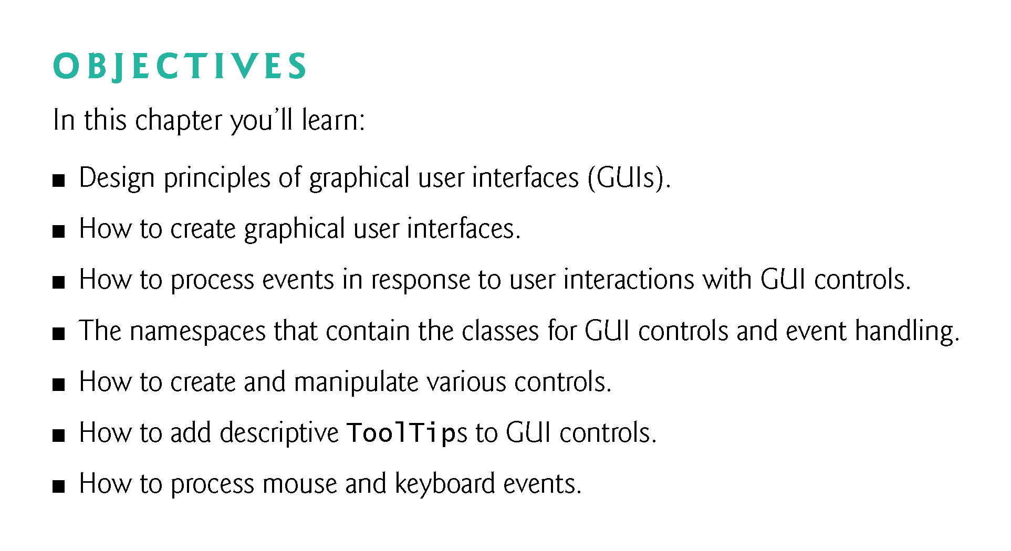

Slide 3
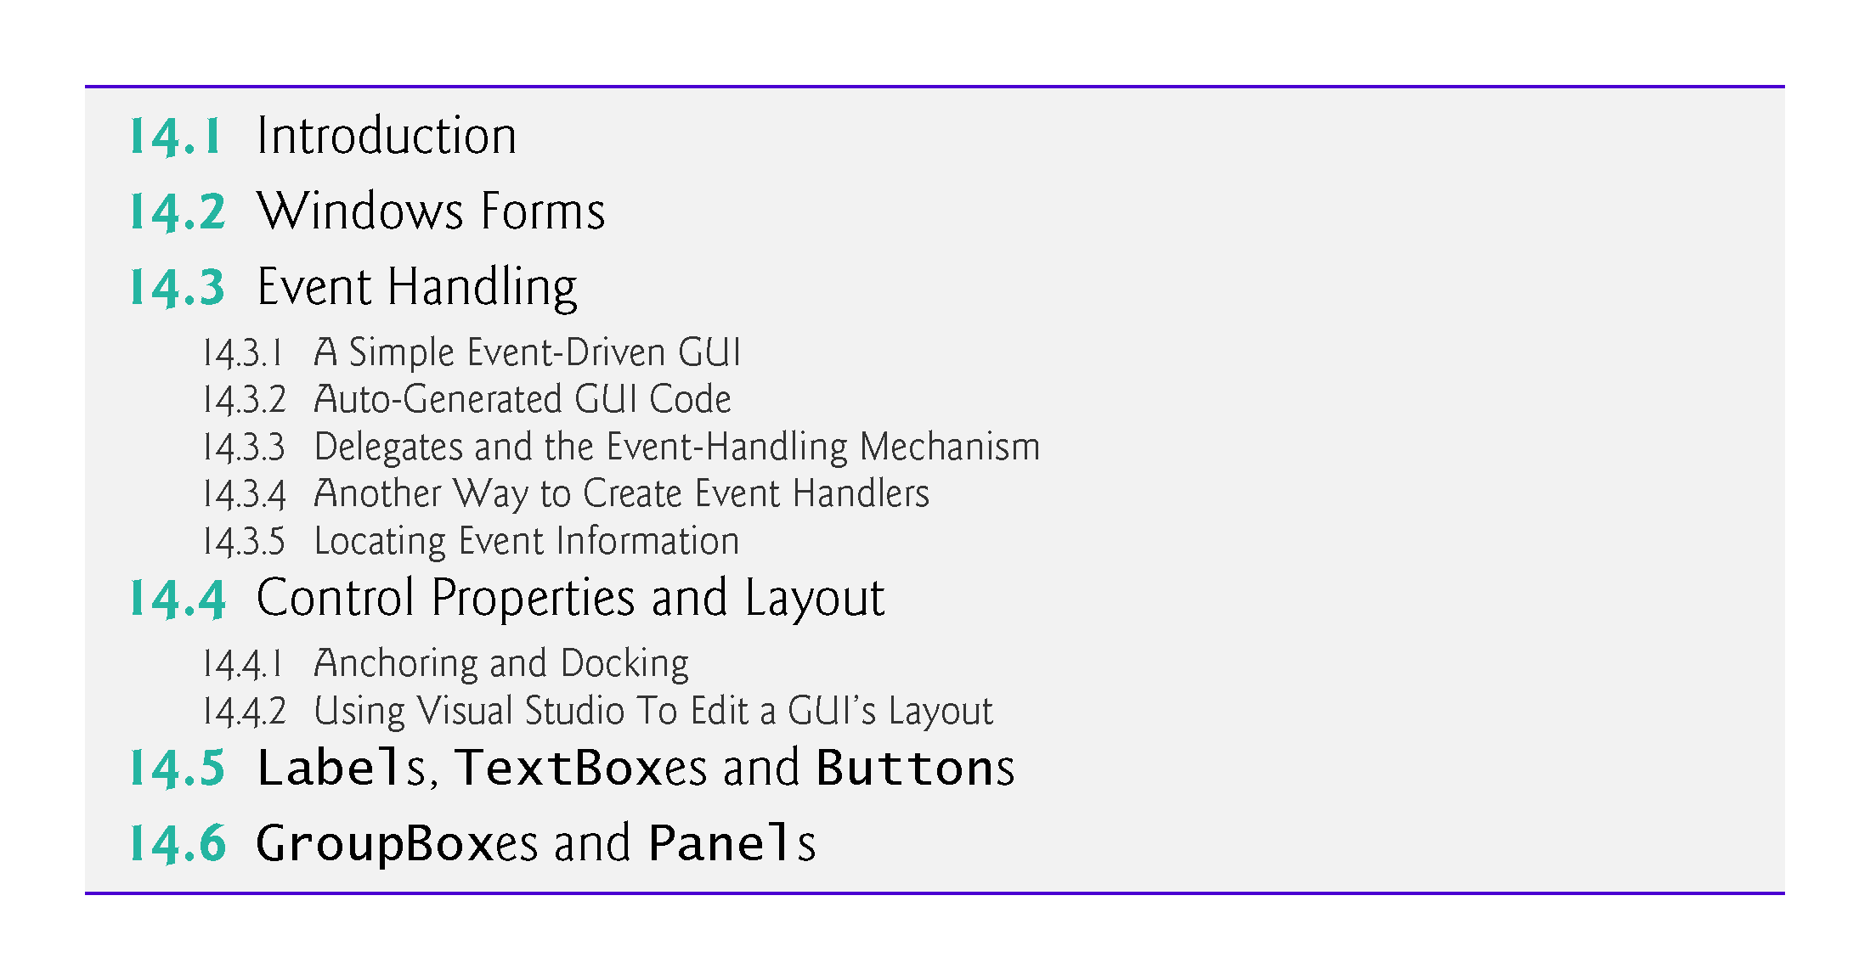

Slide 4
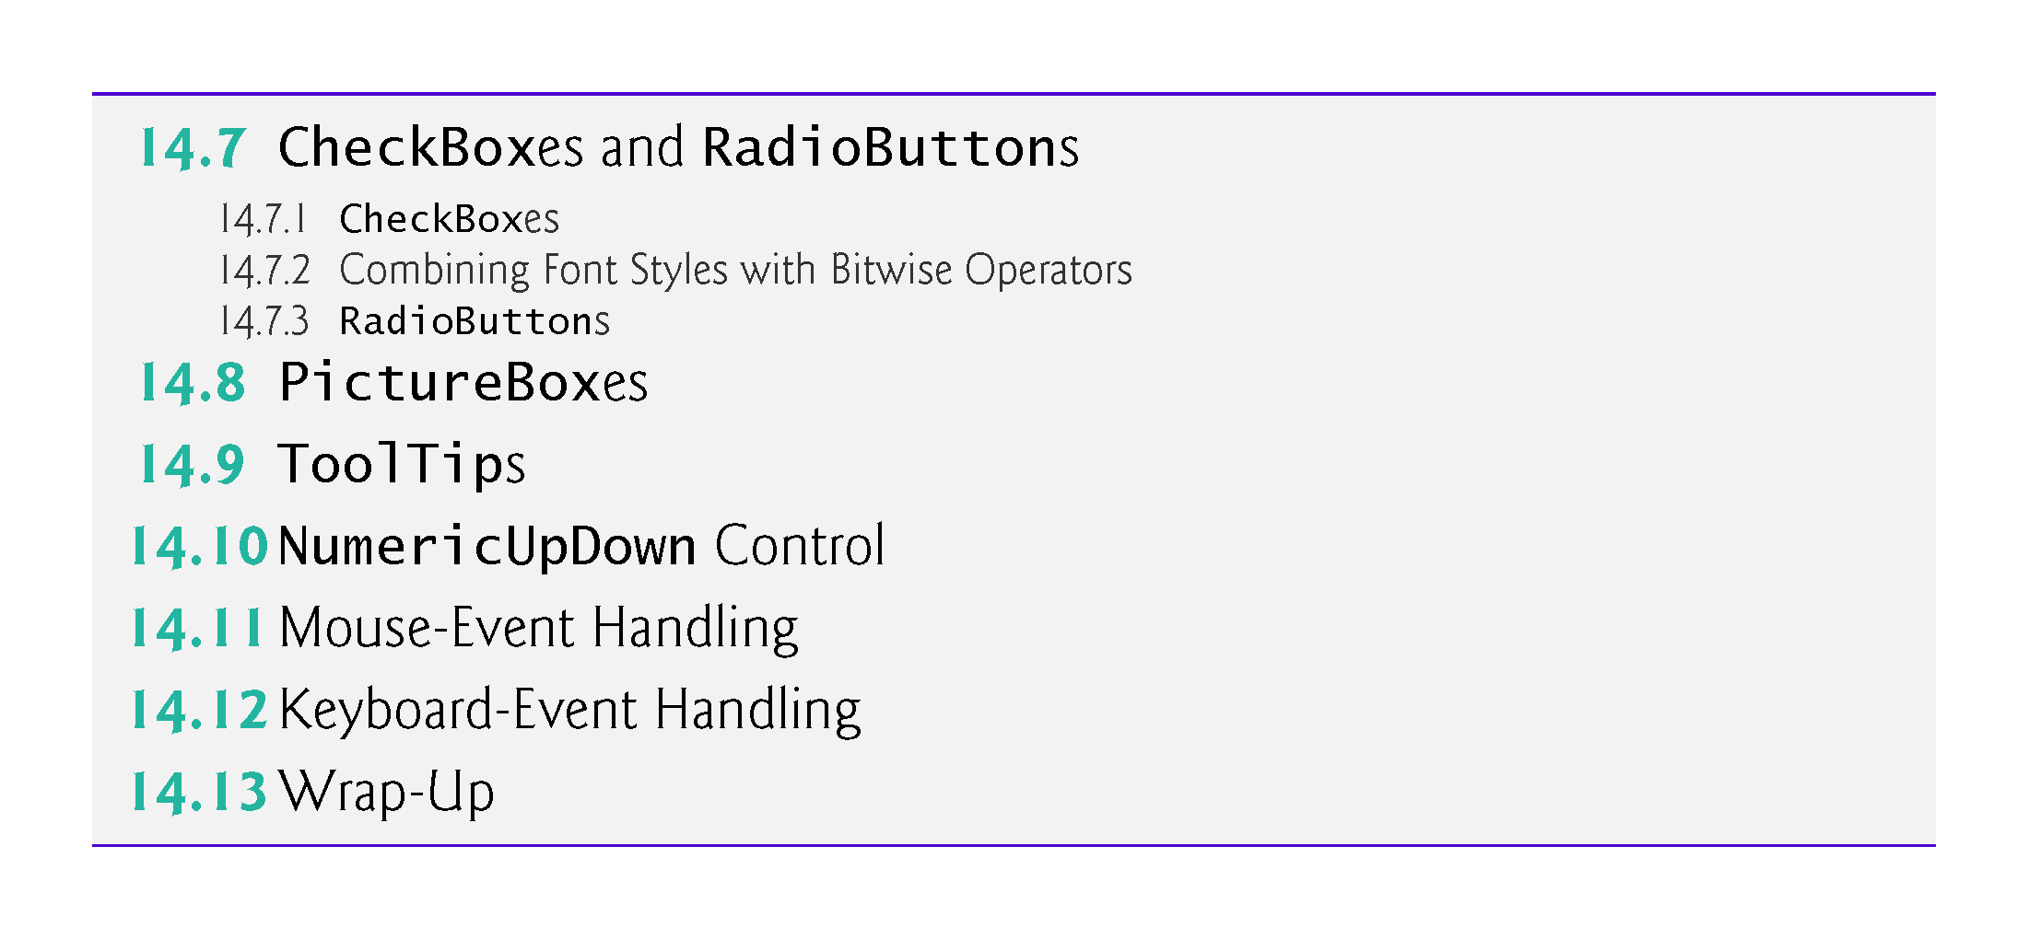

Slide 5
14.1 Introduction
A graphical user interface (GUI) allows a user to interact visually with a program.
Figure 14.1 shows a Visual Studio window containing various GUI controls.

Slide 6
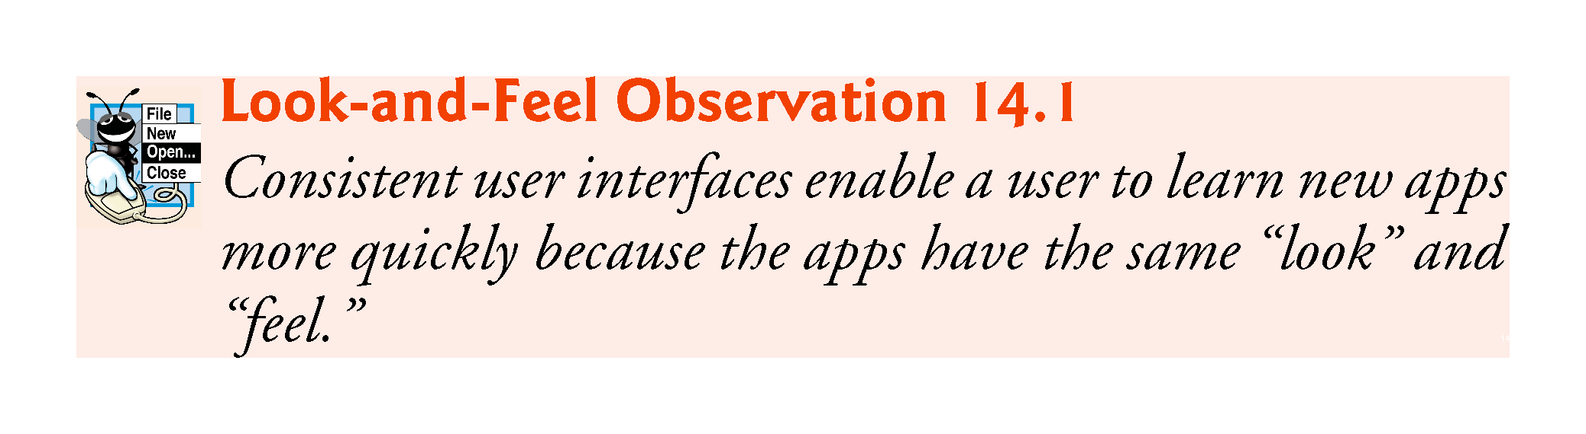

Slide 7
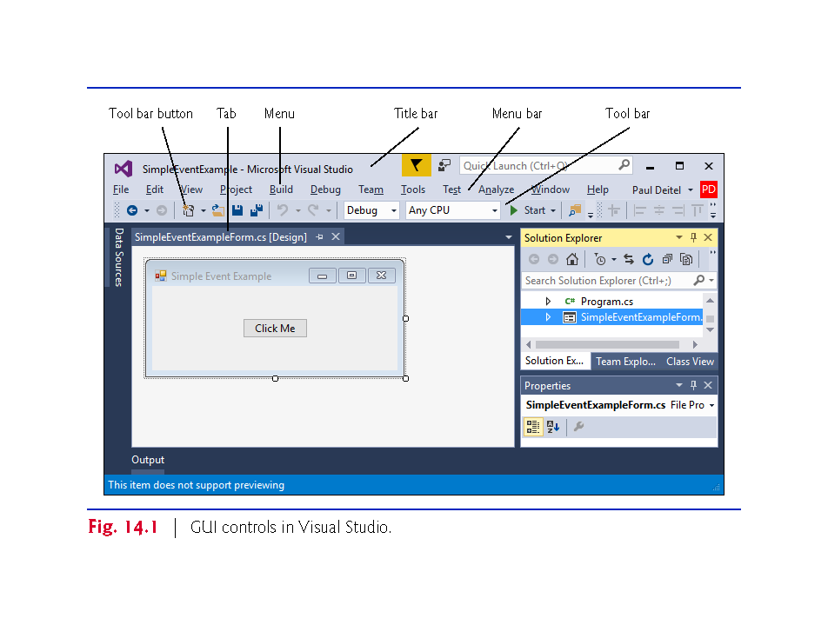

Slide 8
14.1 Introduction (Cont.)
GUI controls are objects that can display information on the screen or enable users to interact with an app.
Several common GUI controls are listed in Fig. 14.2.

Slide 9
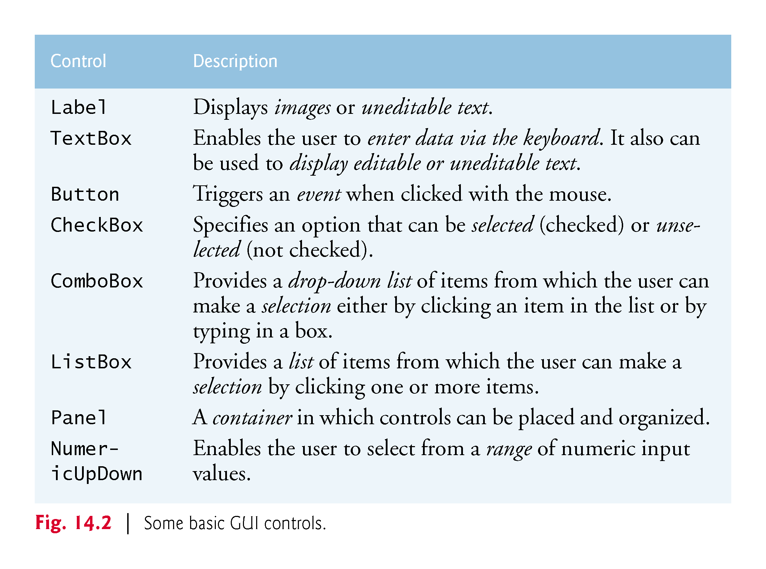

Slide 10
14.2 Windows Forms
A Form（Java Frame） is a graphical element that appears on your computer’s desktop; it can be a dialog, a window or an MDI window.
A component is an instance of a class that implements the IComponent interface, which defines the behaviors that components must implement, such as how the component is loaded.
A control, such as a Button or Label, has a graphical representation at runtime.

Slide 11
14.2 Windows Forms (Cont.)
Figure 14.3 displays the Windows Forms controls and components from the C# Toolbox.
To add a control or component, select it from the Toolbox and drag it onto the Form.
What is the diff between control & component?

Slide 12
Components vs. Controls
https://www.developer.com/guides/components-versus-controls/
Is a button a control or a component? This should be an easy question to answer. A button is a control. What about a list box? How about a group box? How about a timeror a radio button?
If you guessed that the listbox and group box were both controls, you were correct. A radio button is also a control. What do all of these have in common? They have an interface to the user. A timer on the other hand, does not have an interface to the user. As such, it is not a control. It is a component.
The difference between a control and a component is that a control has a user interface and a component does not.

Slide 13
control class and a component class are different
The difference between a control and a component is that a control has a user interface and a component does not.
Timers are non-visual components that generate Tick events at a set interval.
A component is an instance of a class that implements the IComponent interface, which defines the behaviors that components must implement, such as how the component is loaded.
!!!

Slide 14
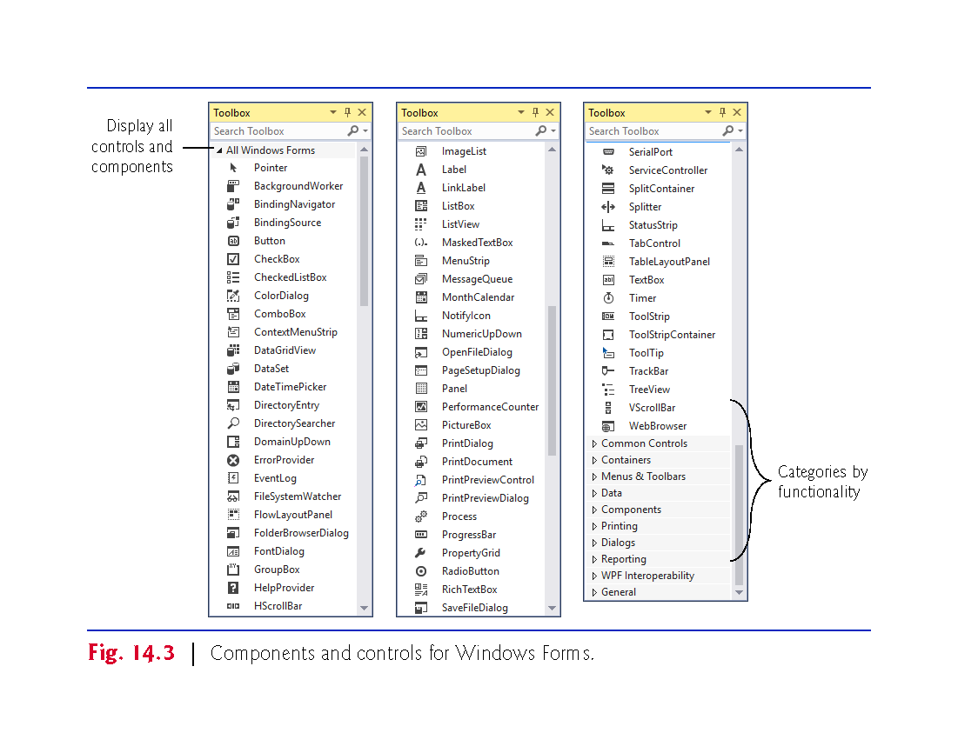

Slide 15
14.2 Windows Forms (Cont.)
The active window is the frontmost and has a highlighted title bar.
A window becomes the active window when the user clicks somewhere inside it.
A Form is a container for controls and components.
When you drag items from the Toolbox onto the Form, Visual Studio generates code that creates the object and sets its basic properties.
The IDE maintains the generated code in a separate file using partial classes??.

Slide 16
14.2 Windows Forms (Cont.)
Figure 14.4 lists common Form properties, common methods and a common event.

Slide 17
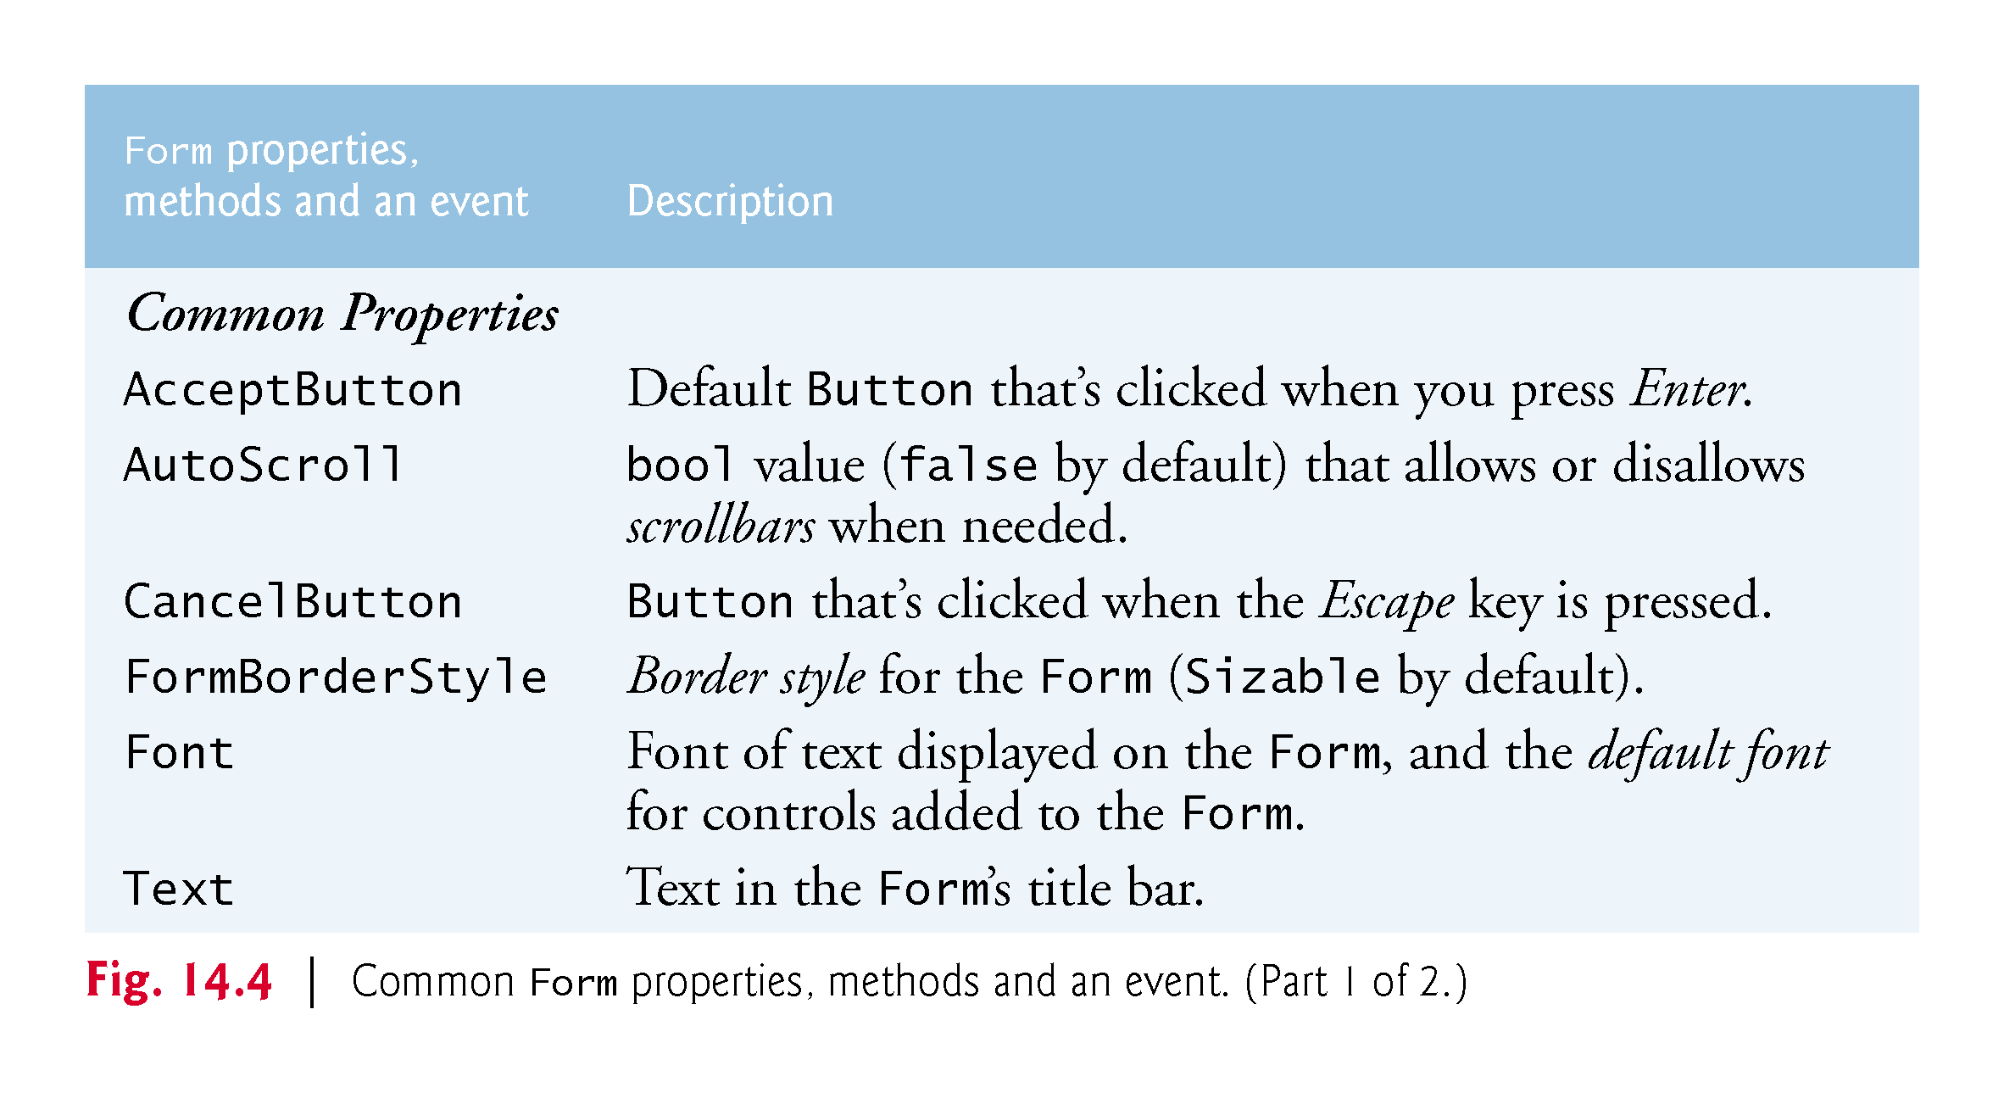

Slide 18
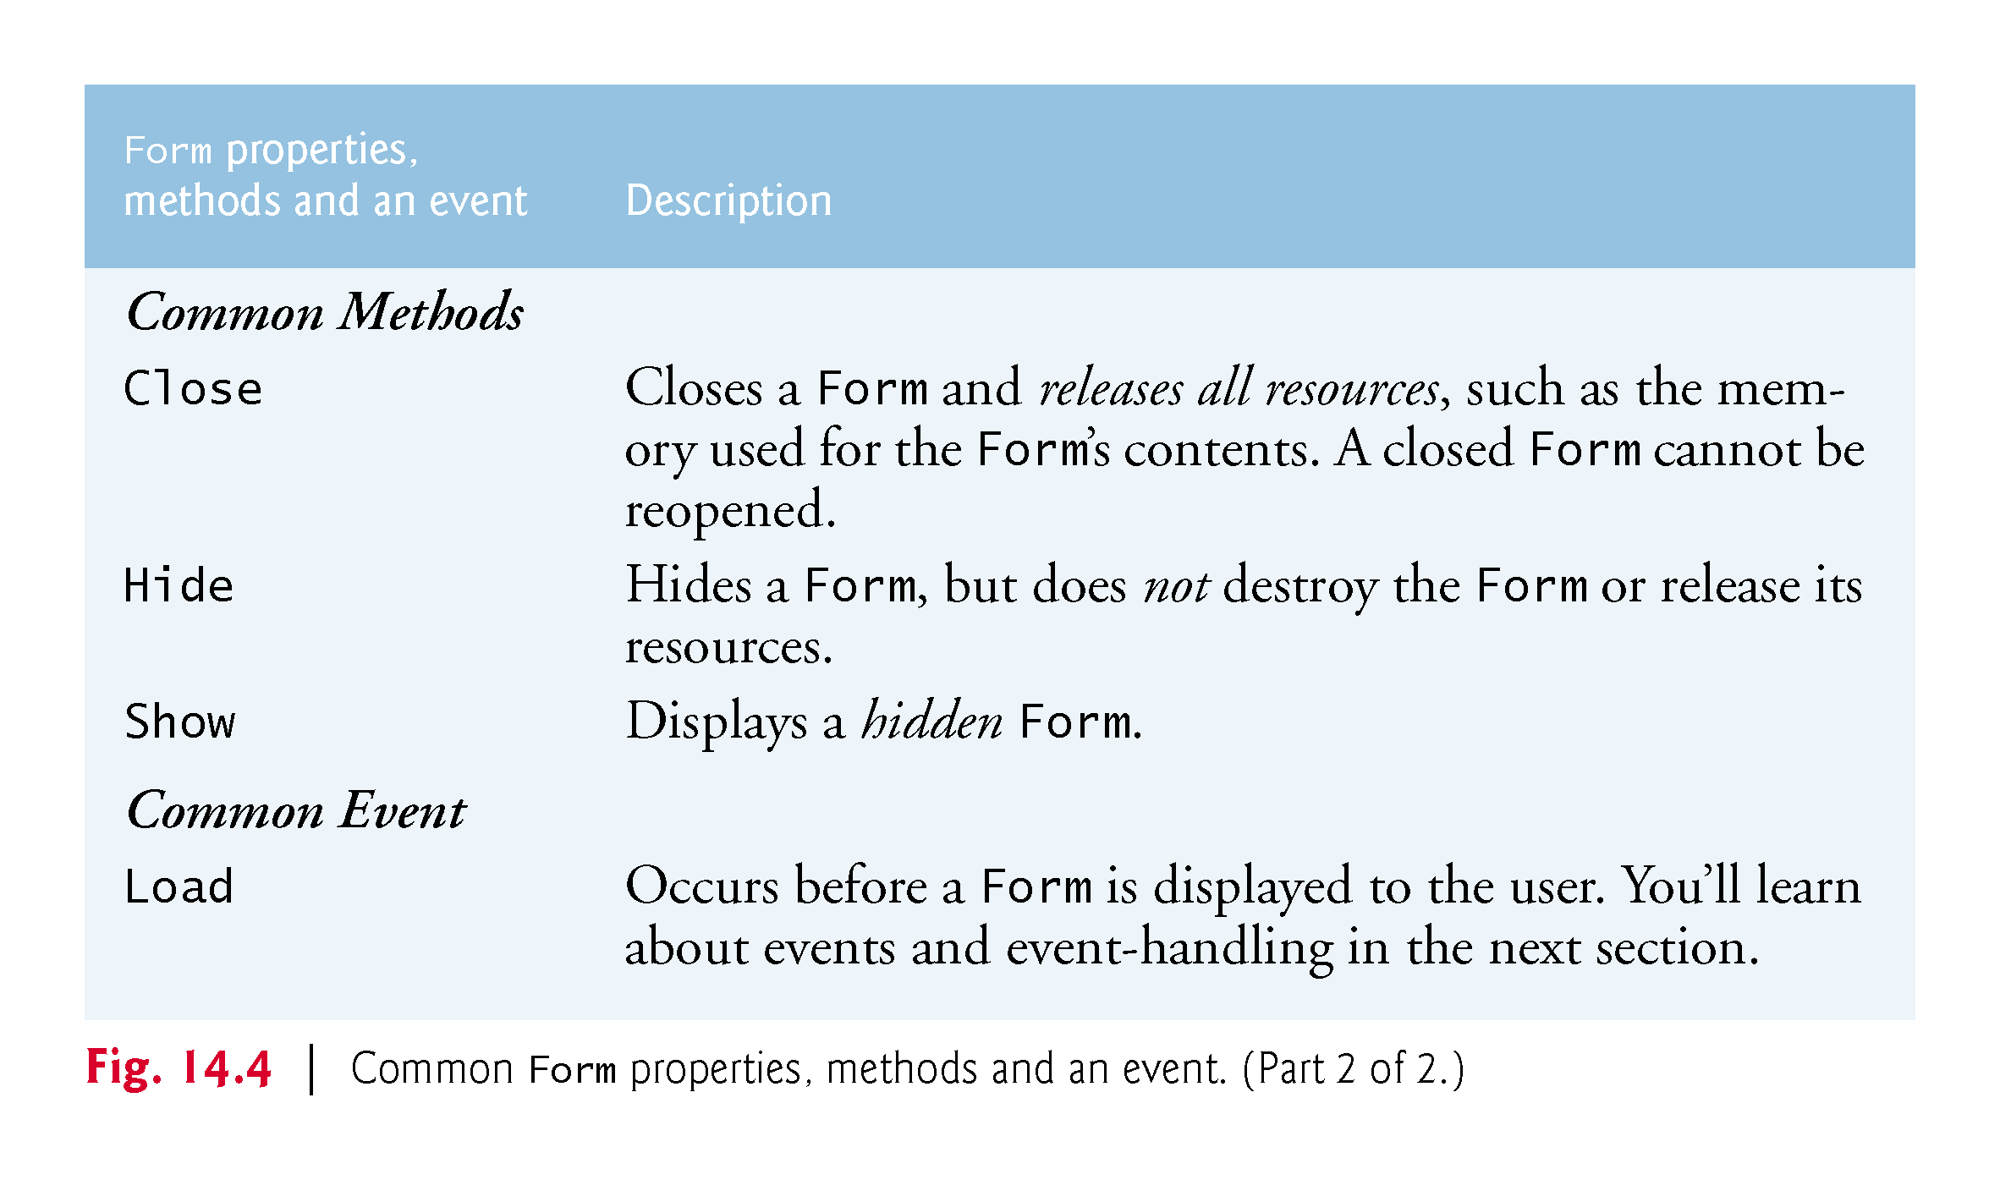

Slide 19
14.3 Event Handling
GUIs are event driven.
When the user interacts with a GUI component, the event drives the program to perform a task.
A method that performs a task in response to an event is called an event handler.

Slide 20
14.3 Event Handling
14.3.1 A Simple Event-Driven GUI
The Form in the app of Fig. 14.5 contains a Button that a user can click to display a MessageBox.

Slide 21
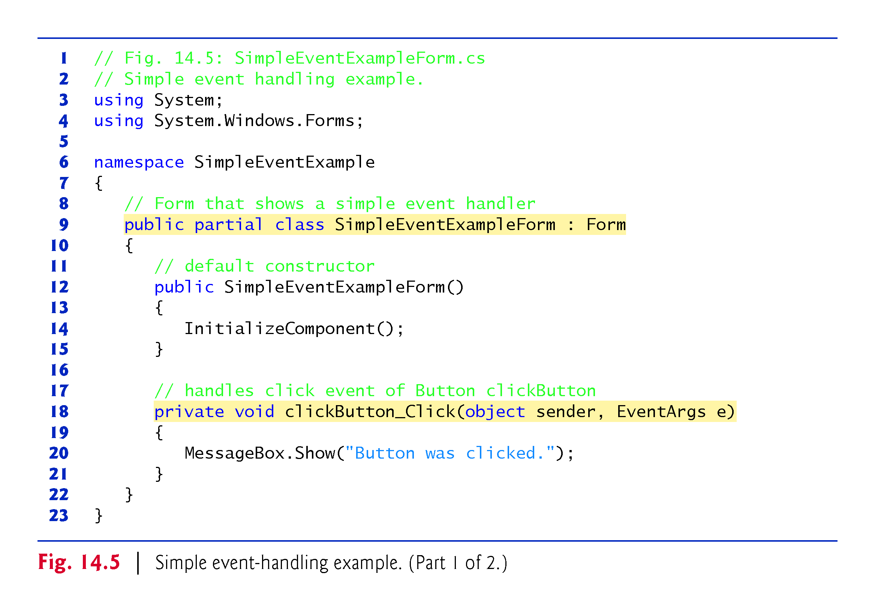

Slide 22
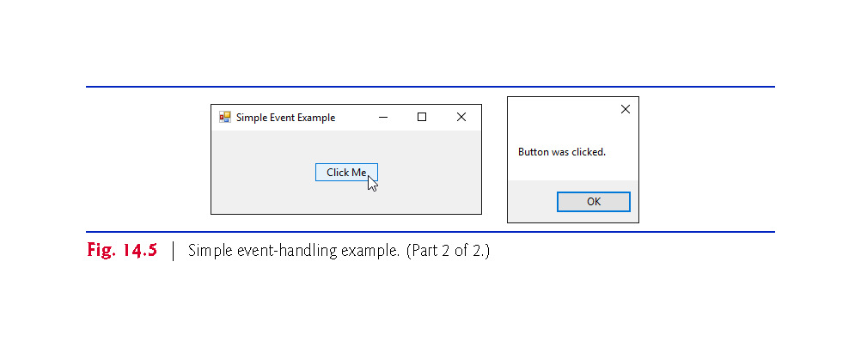

Slide 23
14.3 Event Handling
Adding an Event Handler for the Button’s Click Event
To create the app’s event handler, double click the Button on the Form.
The following empty event handler is declared:
private void clickButton_Click (object sender, EventArgs e) { }
By convention, the IDE names the event-handler method as objectName_eventName (e.g., clickButton_Click).

Slide 24
14.3 Event Handling (Cont.)
Event Handler Parameters
Each event handler receives two parameters when it’s called:
This first—an object reference typically named sender—is a reference to the object that generated the event.
The second is a reference to an EventArgs object (or an object of an EventArgs derived class) which contains additional information about the event.

Slide 25
14.3 Event Handling (Cont.)
14.3.2 Auto-Generated GUI Code
Visual Studio places the auto-generated code in the Designer.cs file of the Form.
Open this file by expanding the node in the Solution Explorer window for the file you’re currently working in (SimpleEventExampleForm.cs) and double clicking the file name that ends with Designer.cs.
Since this code (Figs. 14.6 and 14.7) is created and maintained by Visual Studio, you generally don’t need to look at it.
!!!
!!!

Slide 26
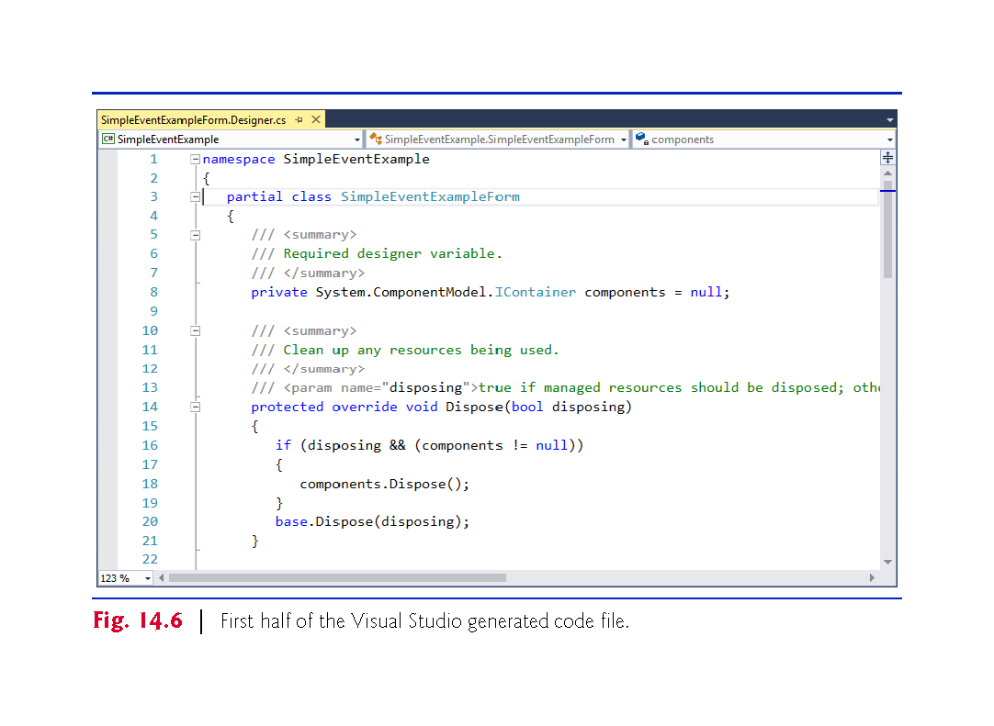

Slide 27
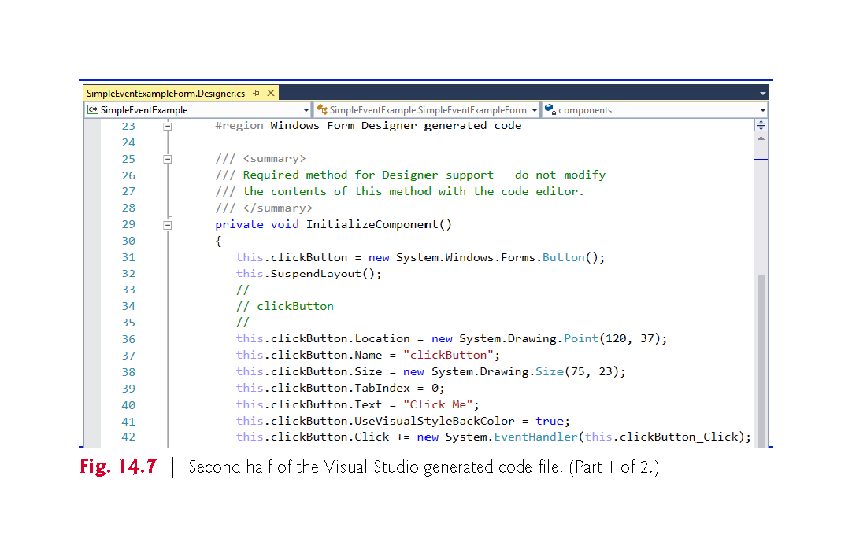

Slide 28
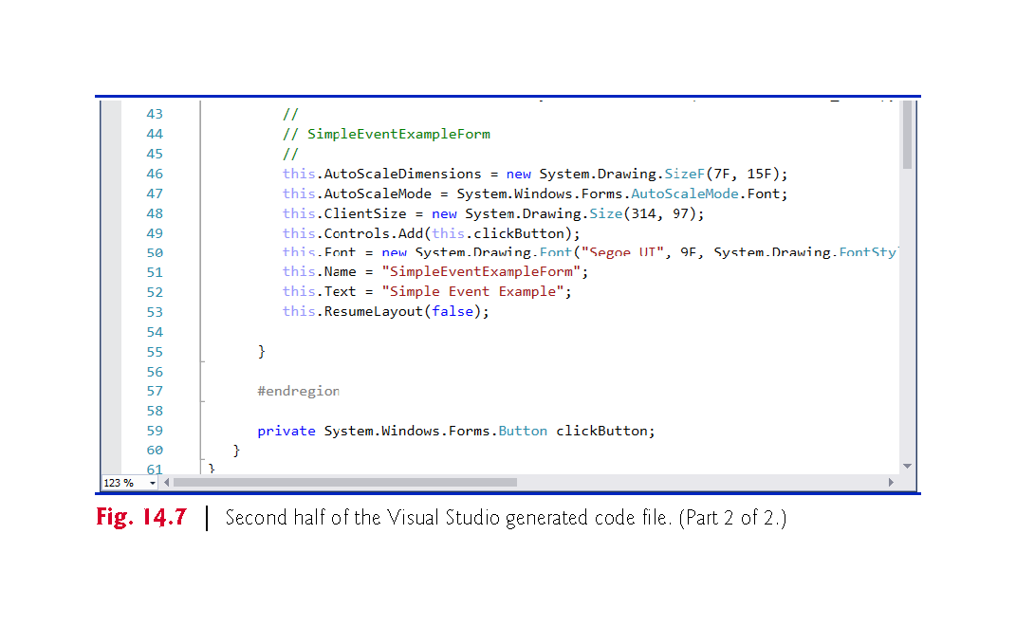

Slide 29
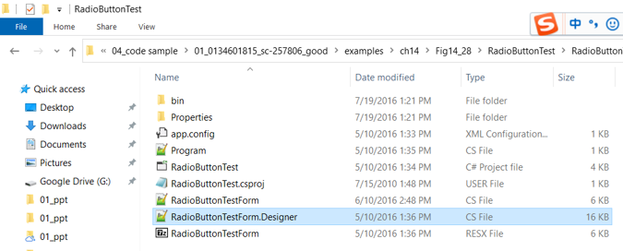
Two .cs files
*form.cs //event handler
*.design.cs //auto generated GUI
!!!

Slide 30
14.3 Event Handling (Cont.) ??
The partial modifier(?) allows the Form’s class to be split among multiple files.
Fig. 14.7 declares the clickButton that we created in Design mode. It’s declared as an instance variable of class SimpleEventExampleForm.
The property values correspond to the values set in the Properties window for each control.
Method InitializeComponent is called when the Form is created.

Slide 31
Partial Classes and Methods (C# Programming Guide)
It is possible to split the definition of a class, a struct, an interface or a method over two or more source files.
Each source file contains a section of the type or method definition, and all parts are combined when the application is compiled.
https://docs.microsoft.com/en-us/dotnet/csharp/programming-guide/classes-and-structs/partial-classes-and-methods

Slide 32
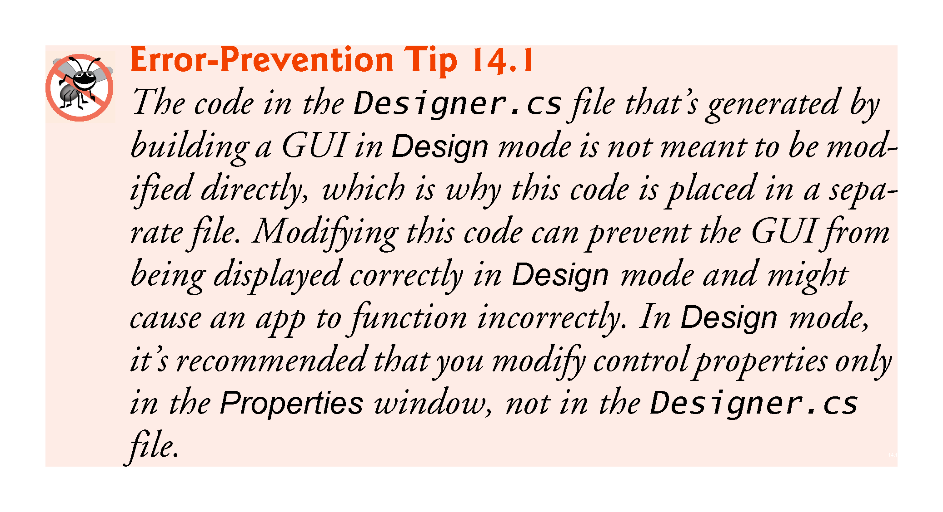
P
!!!

Slide 33
14.3 Event Handling (Cont.) ?
14.3.3 Delegates and the Event-Handling Mechanism
Event handlers are connected to a control’s events via special objects called delegates.
A delegate type declaration specifies the signature of a method—in event handling, the signature specifies the return type and arguments for an event handler.
A delegate of type EventHandler can hold references to methods that return void and receive two parameters—one of type object and one of type EventArgs:
public delegate void EventHandler(object sender, EventArgs e);

Slide 34
14.3 Event Handling (Cont.)??
Indicating the Method that a Delegate Should Call
A Button calls its EventHandler delegate in response to a click.
The delegate’s job is to invoke the appropriate method.
This code is added by Visual Studio when you double click the Button control in Design mode:
new System.EventHandler(this.clickButton_Click);
Adding more delegates to an event is called multicast delegates.

Slide 35
14.3 Event Handling (Cont.)
14.3.4 Another Way to Create Event Handlers
Using the Properties Window to Create Event Handlers
Controls can generate many different events.
Clicking the Events icon (the lightning-bolt icon) in the Properties window (Fig. 14.8), displays all the events for the selected control.

Slide 36
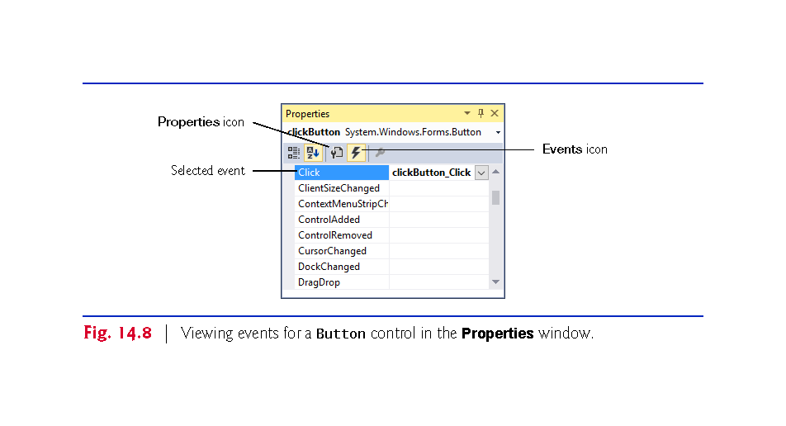

Slide 37
14.3 Event Handling (Cont.)
14.3.5 Locating Event Information
Read the Visual Studio documentation to learn about the different events raised by each control.
To do this, select a control in the IDE and press the F1 key to display that control’s online help (Fig. 14.9).
The web page that's displayed contains basic information about the control’s class.

Slide 38
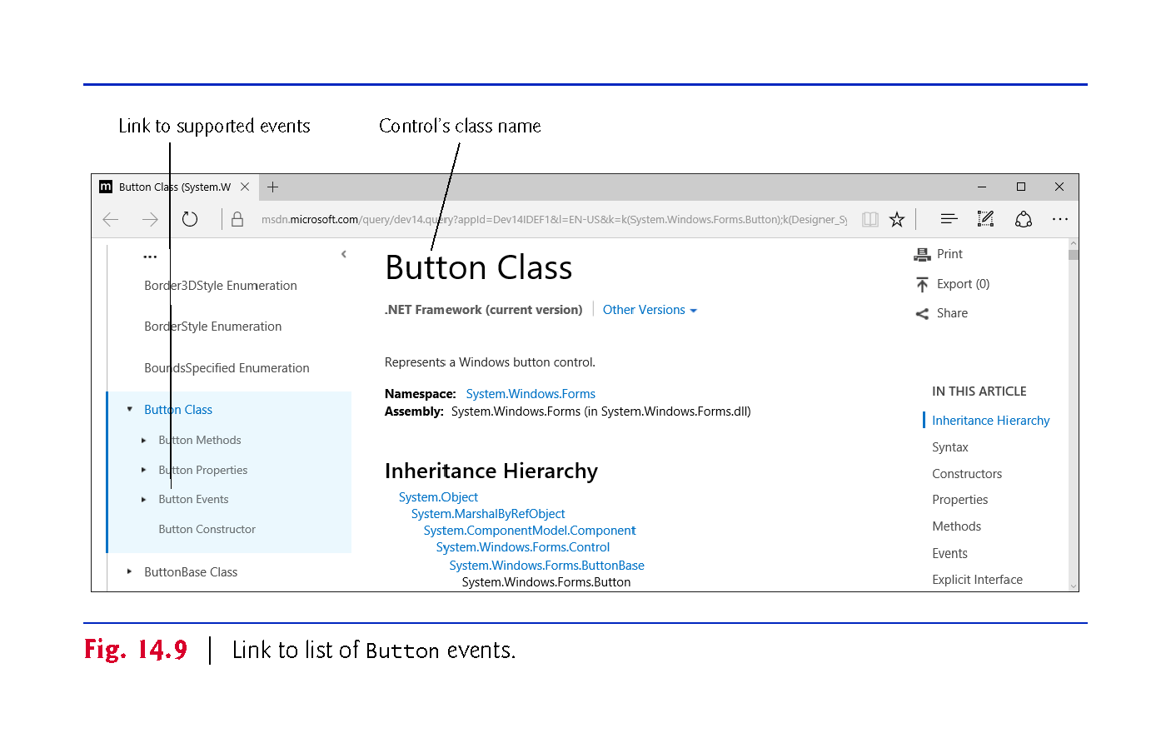

Slide 39
14.3 Event Handling (Cont.)
Click the name of an event to view its description and examples of its use.
We selected the Click event to display the information in Fig. 14.10.

Slide 40
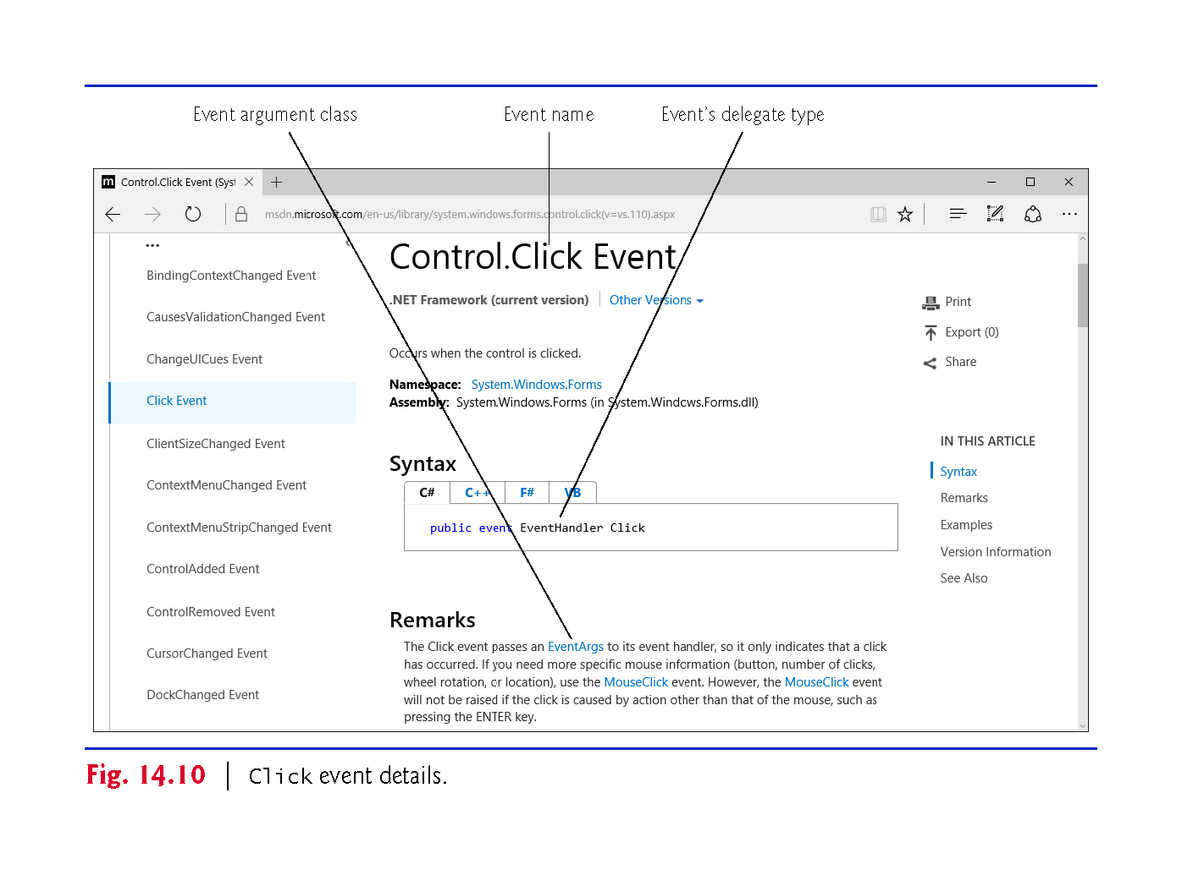

Slide 41
14.4 Control Properties and Layout
Controls derive from class Control (namespace System.Windows.Forms).
Figure 14.11 lists some of class Control’s properties and methods.

Slide 42
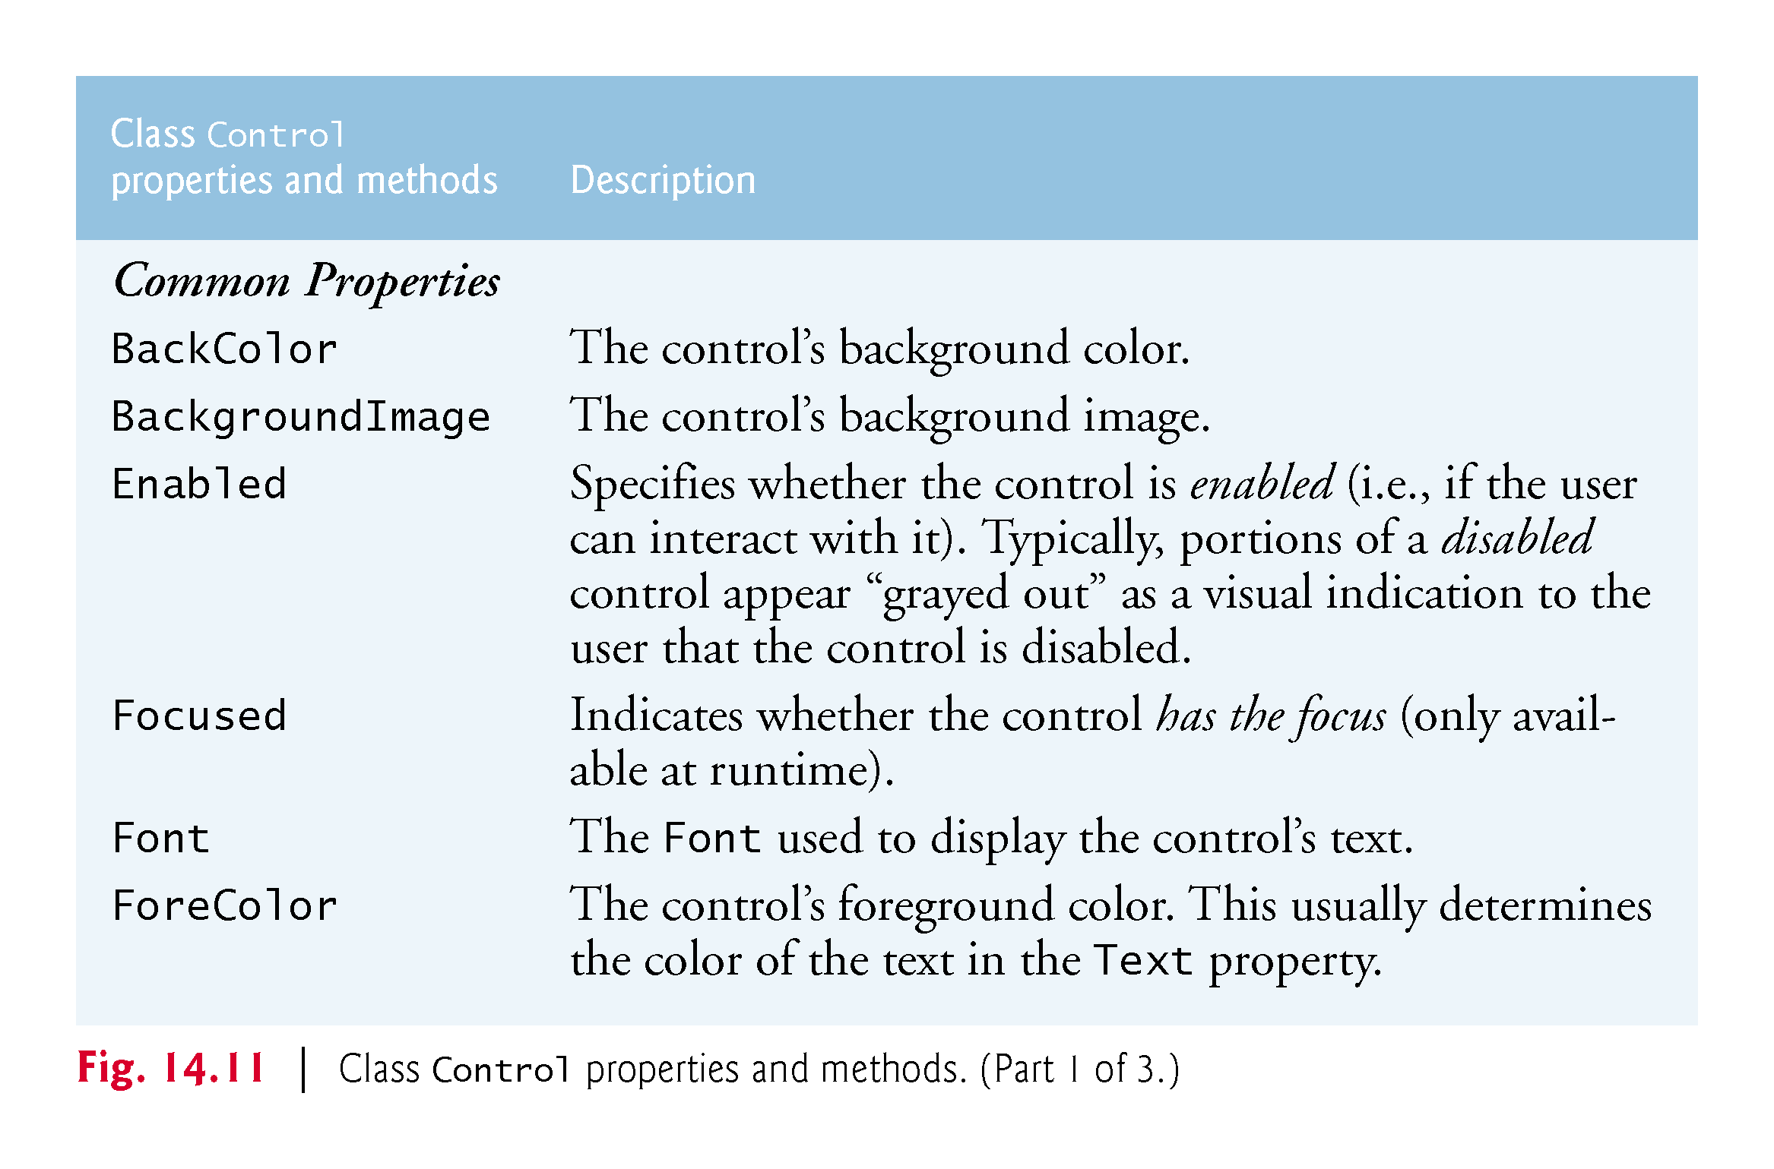

Slide 43
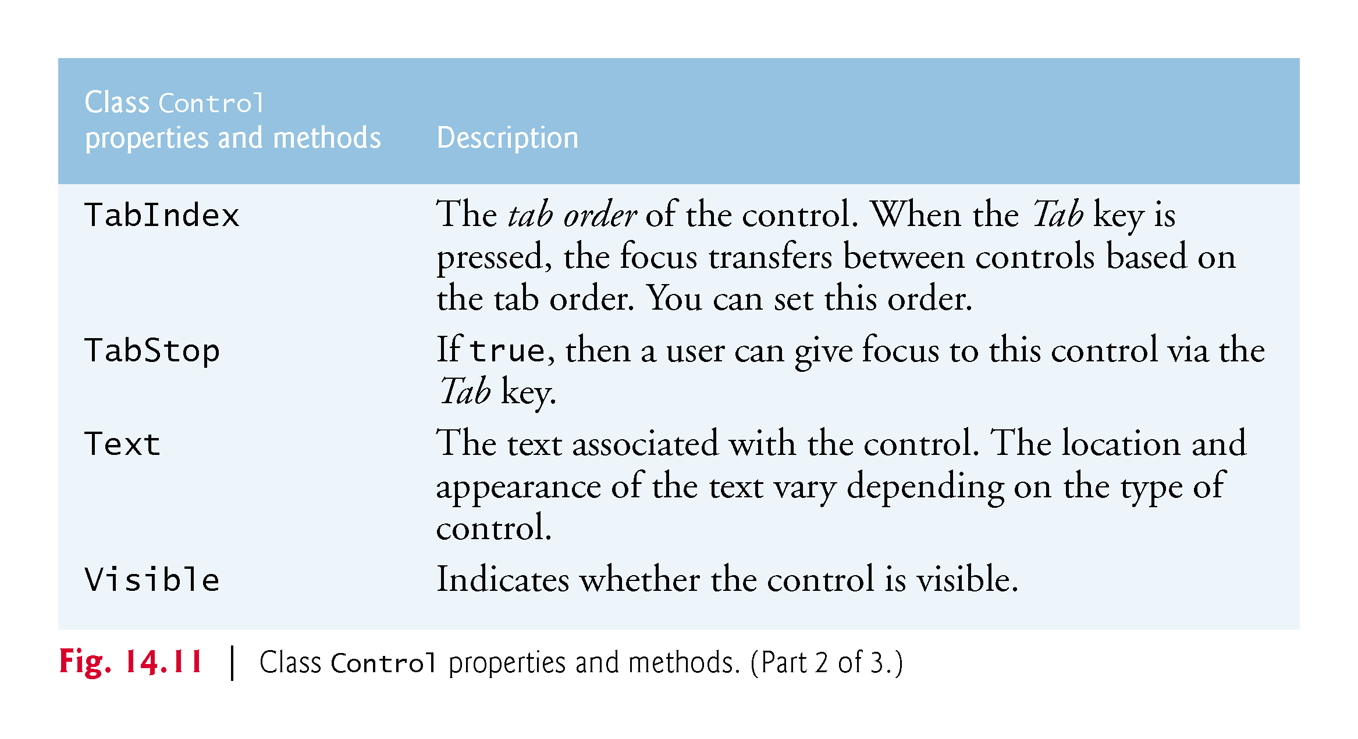

Slide 44
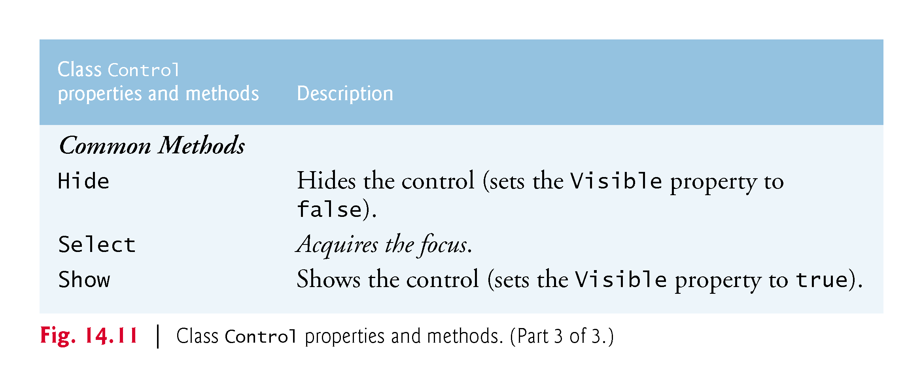

Slide 45
14.4 Control Properties and Layout (Cont.)
Anchoring and Docking
Anchoring causes controls to remain at a fixed distance from the sides of the container.
Anchor a control to the right and bottom sides by setting the Anchor property (Fig. 14.12).
!!!

Slide 46
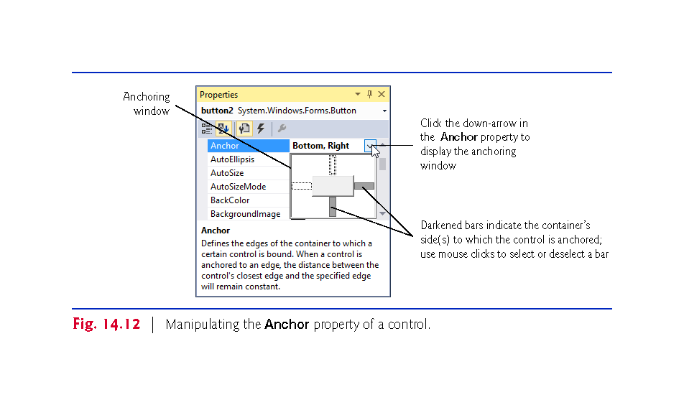

Slide 47
14.4 Control Properties and Layout (Cont.)
Execute the app and enlarge the Form (Fig. 14.13).

Slide 48
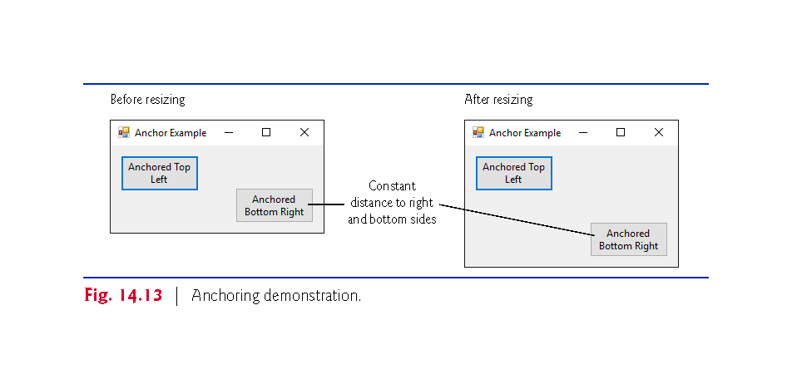

Slide 49
14.4 Control Properties and Layout (Cont.)
!!!
Docking attaches a control to a container such that the control stretches across an entire side?? or fills an entire area.
Docking allows a control to span an entire side of its parent container or to fill the entire container (Fig. 14.14).
The Form’s Padding property specifies the distance between the docked controls and the edges.

Slide 50
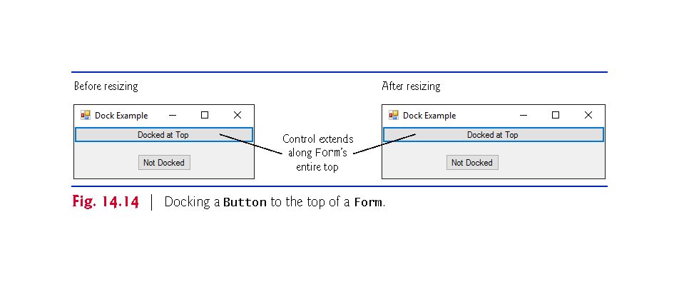

Slide 51
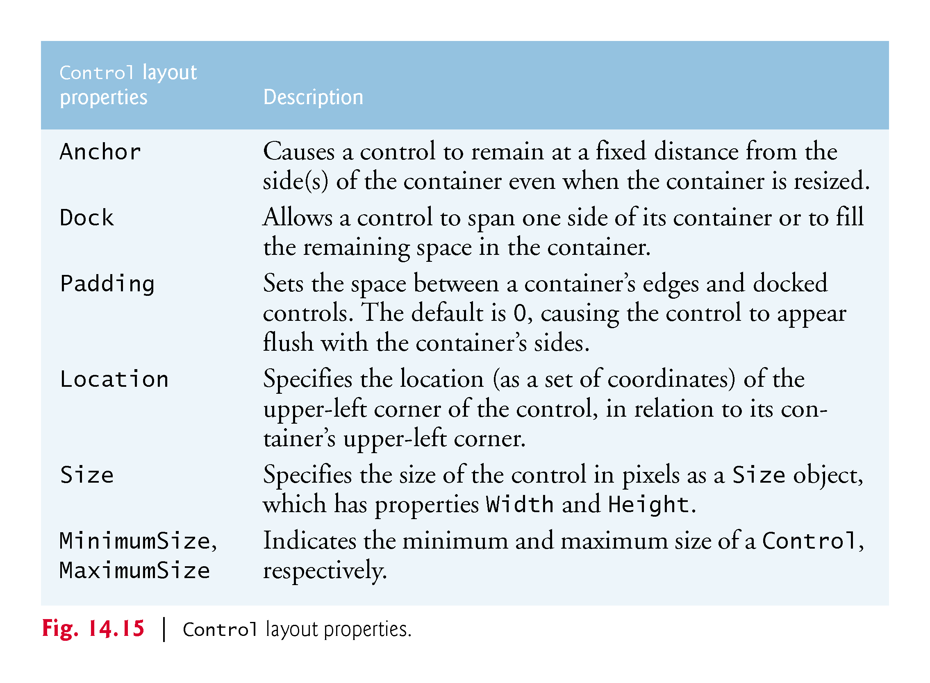
!!!
!!!
Notes:
Anchoring
抛锚 anchor, break down, drop anchor, cast anchor, lie at anchor
泊 berth, moor, anchor, touch
Dock
码头
Mǎtóu
Padding
填充
filling, padding

Slide 52
14.4 Control Properties and Layout (Cont.)
Using Visual Studio To Edit a GUI’s Layout
Visual Studio provides tools that help you with GUI layout.
When dragging a control across a Form（Frame in Java）, blue lines (known as snap lines) help you position the control (Fig. 14.16).
Visual Studio also provides the Format menu, which contains several options for modifying your GUI’s layout.

Slide 53
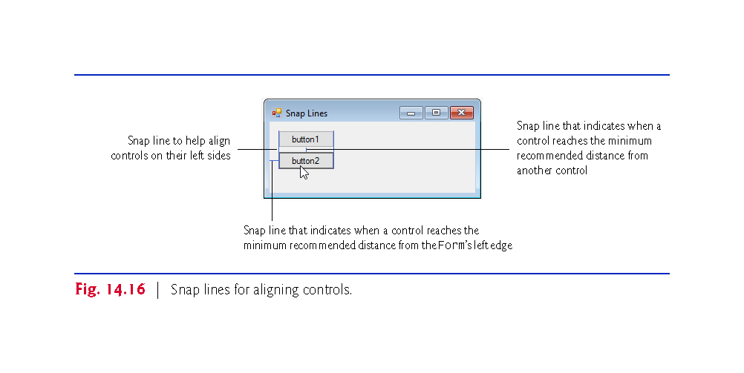
Notes:
snap line Duìqí xiàn

Slide 54
14.5 Labels, TextBoxes and Buttons
Labels display text that the user cannot directly modify.
Figure 14.7 lists common Label properties.

Slide 55
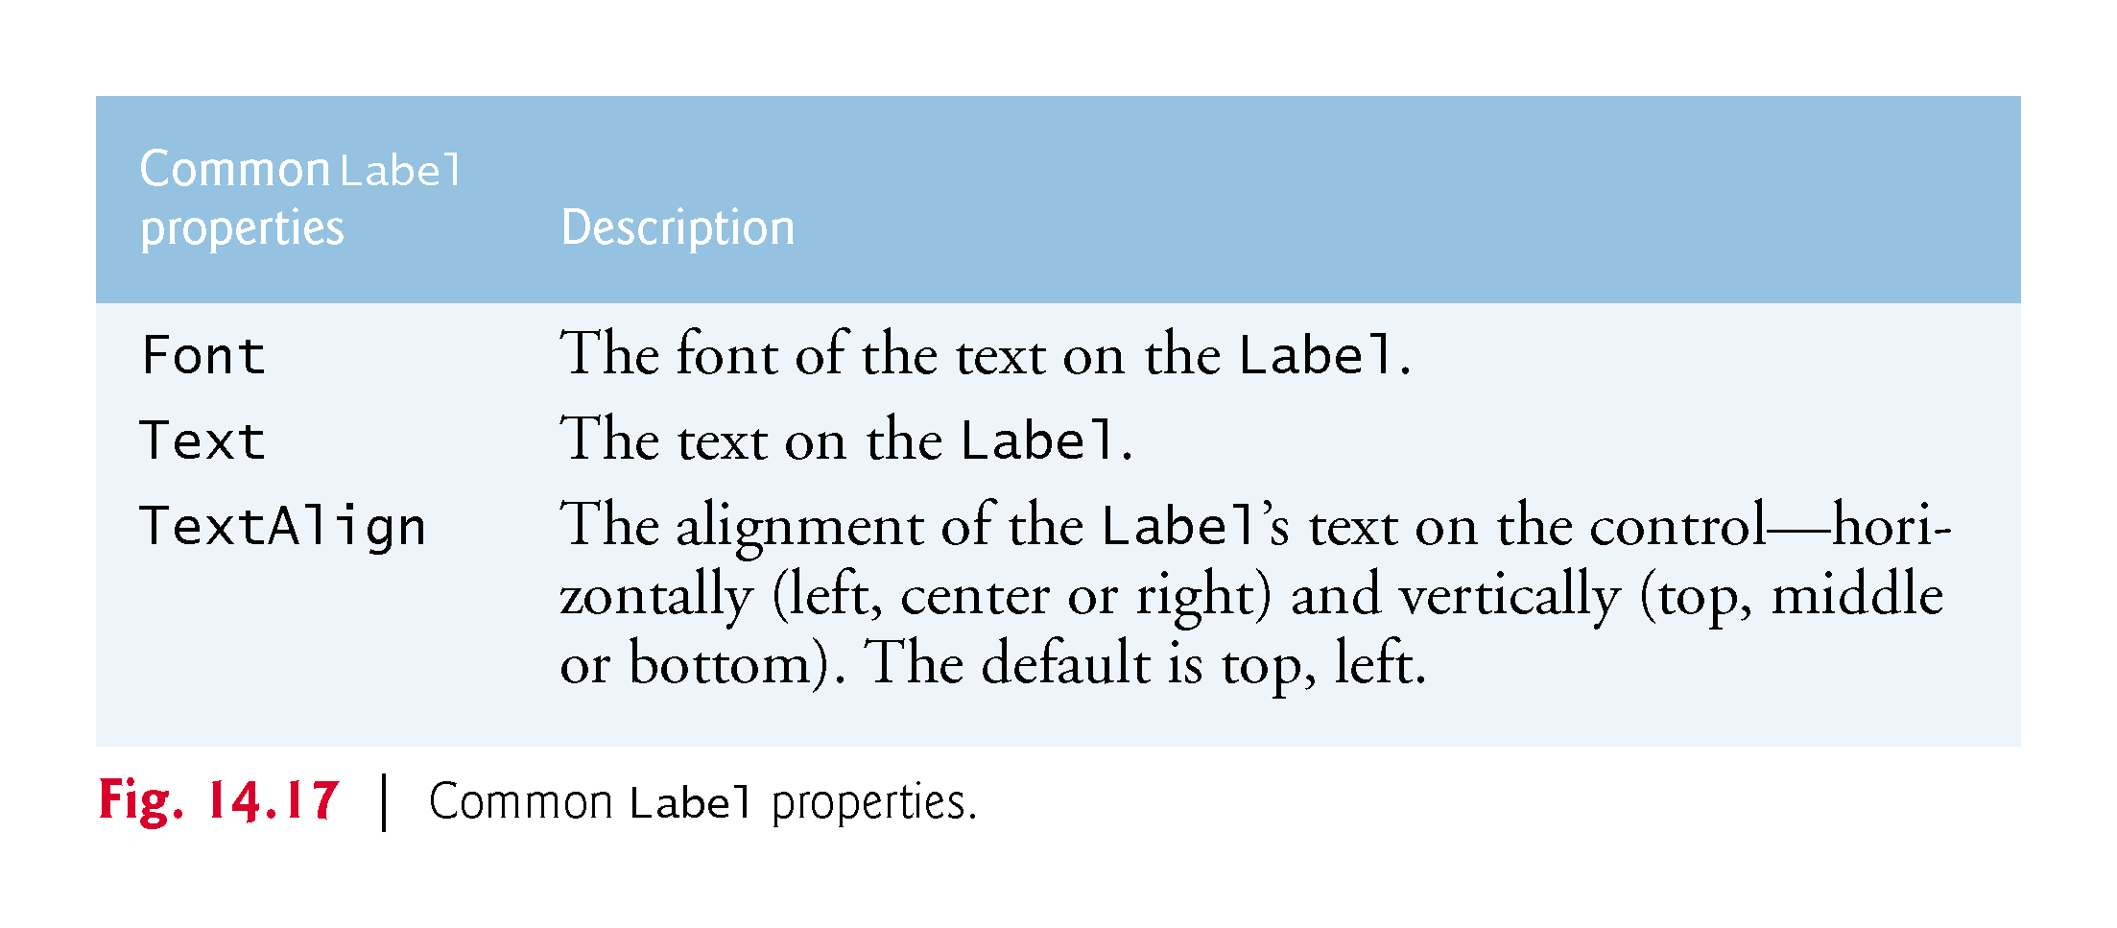

Slide 56
14.5 Labels, TextBoxes and Buttons (Cont.)
A TextBox (Fig. 14.18) is an area in which either text can be displayed by a program or the user can type text via the keyboard.
If you set the property UseSystemPasswordChar to true, the TextBox becomes a password TextBox.

Slide 57
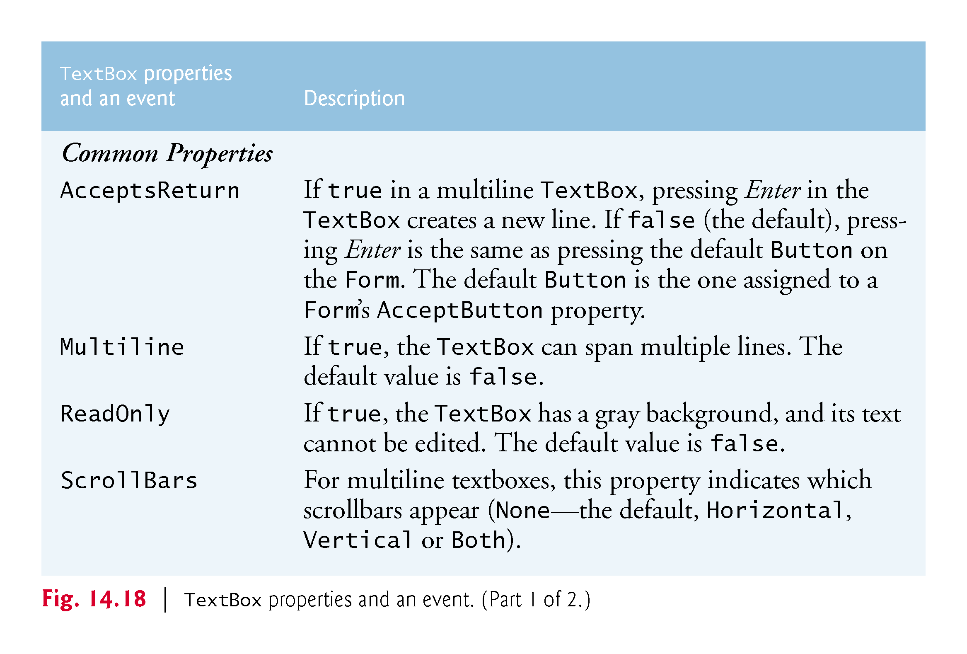

Slide 58
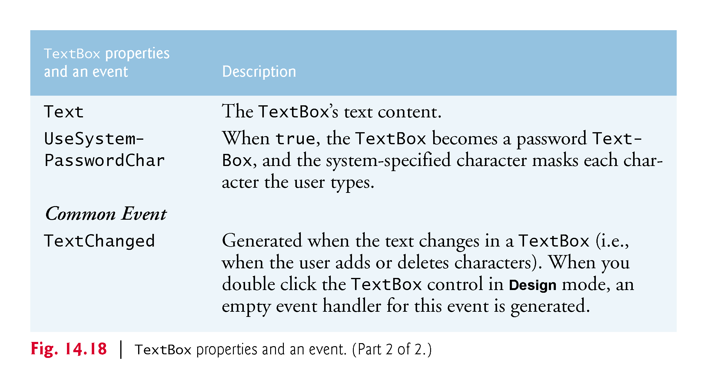

Slide 59
14.5 Labels, TextBoxes and Buttons (Cont.)
A button is a control that the user clicks to trigger a specific action or to select an option in a program.
A program can use several types of buttons, but all the button classes derive from class ButtonBase.

Slide 60
14.5 Labels, TextBoxes and Buttons (Cont.)
Figure 14.19 lists common properties and a common event of class Button.

Slide 61
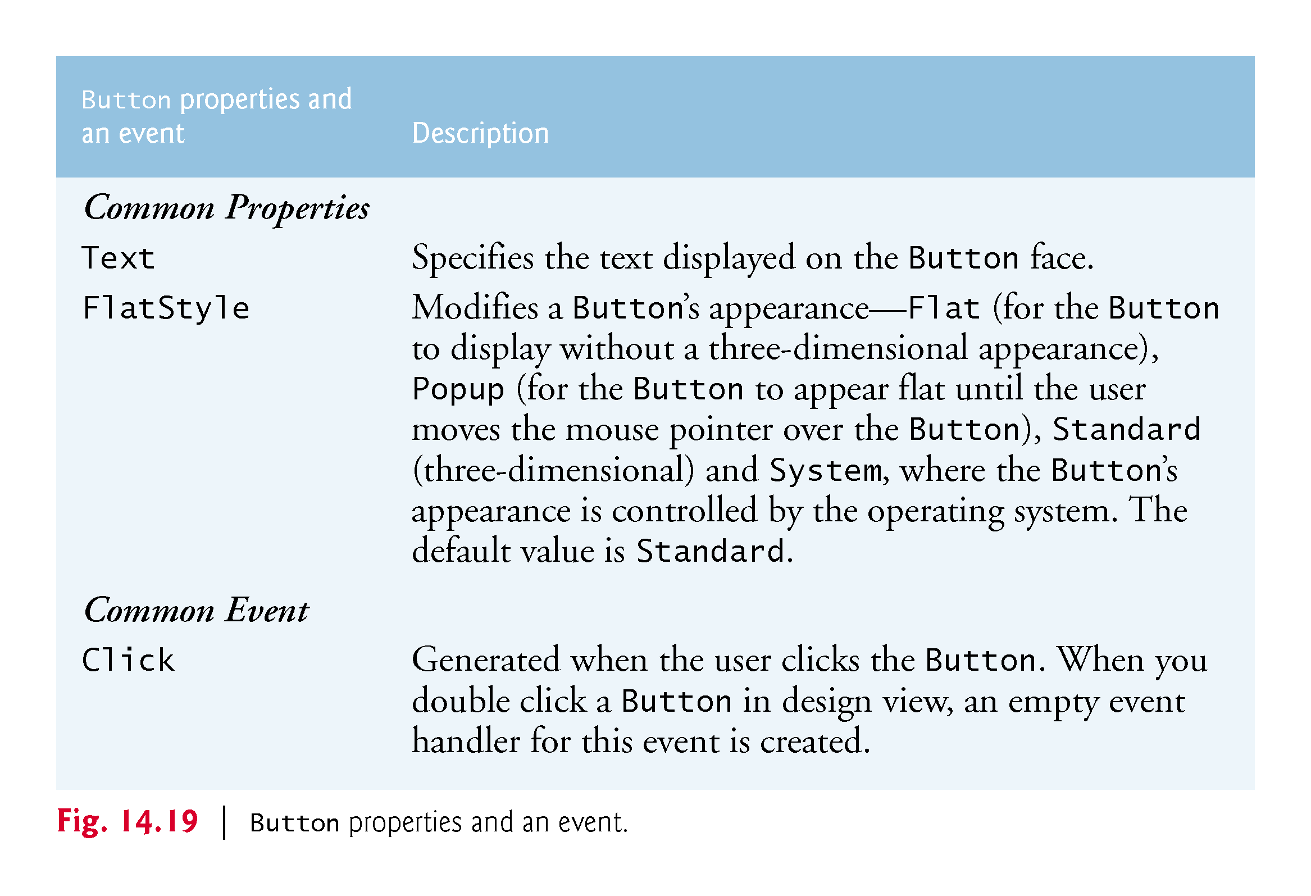

Slide 62
14.5 Labels, TextBoxes and Buttons (Cont.)
Figure 14.20 uses a TextBox, a Button and a Label.

Slide 63
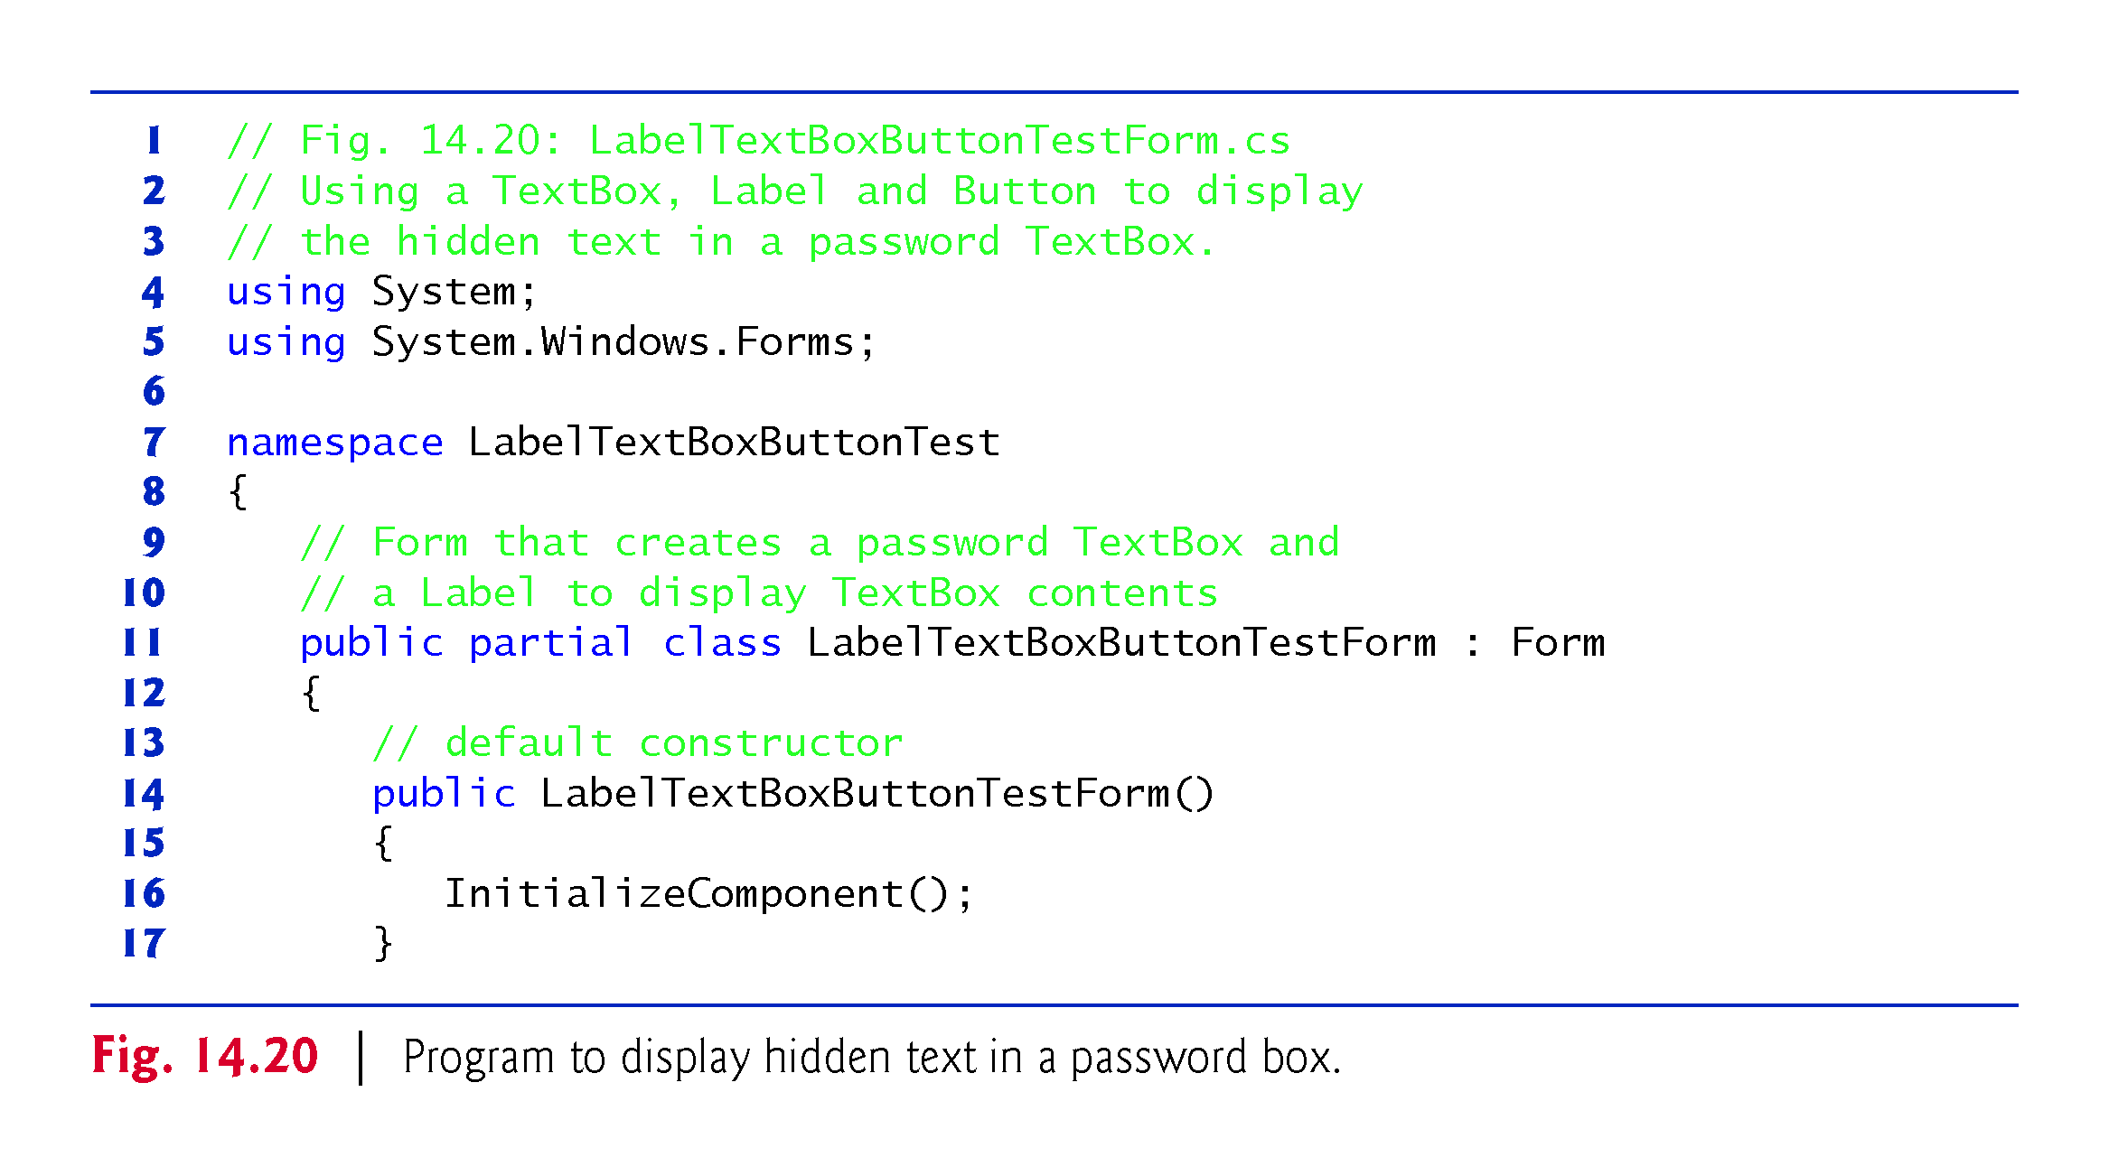

Slide 64
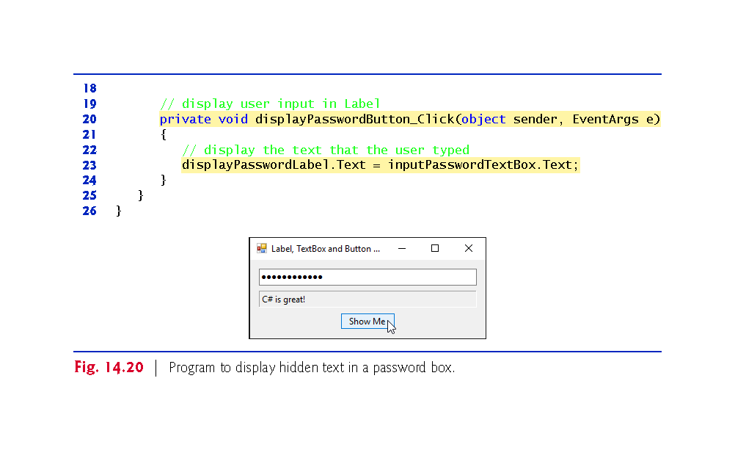

Slide 65
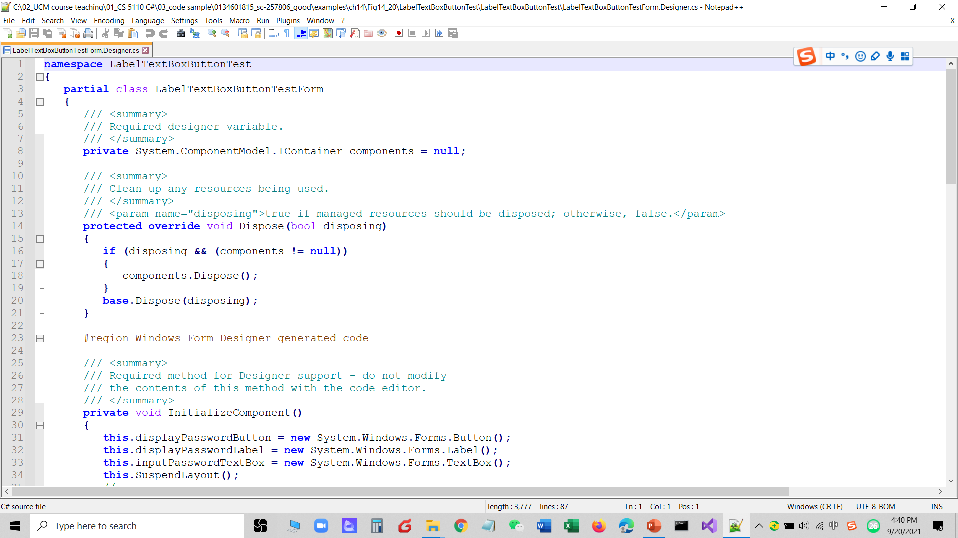
LabelTextBoxButtonTestForm.Designer
constructor

Slide 66
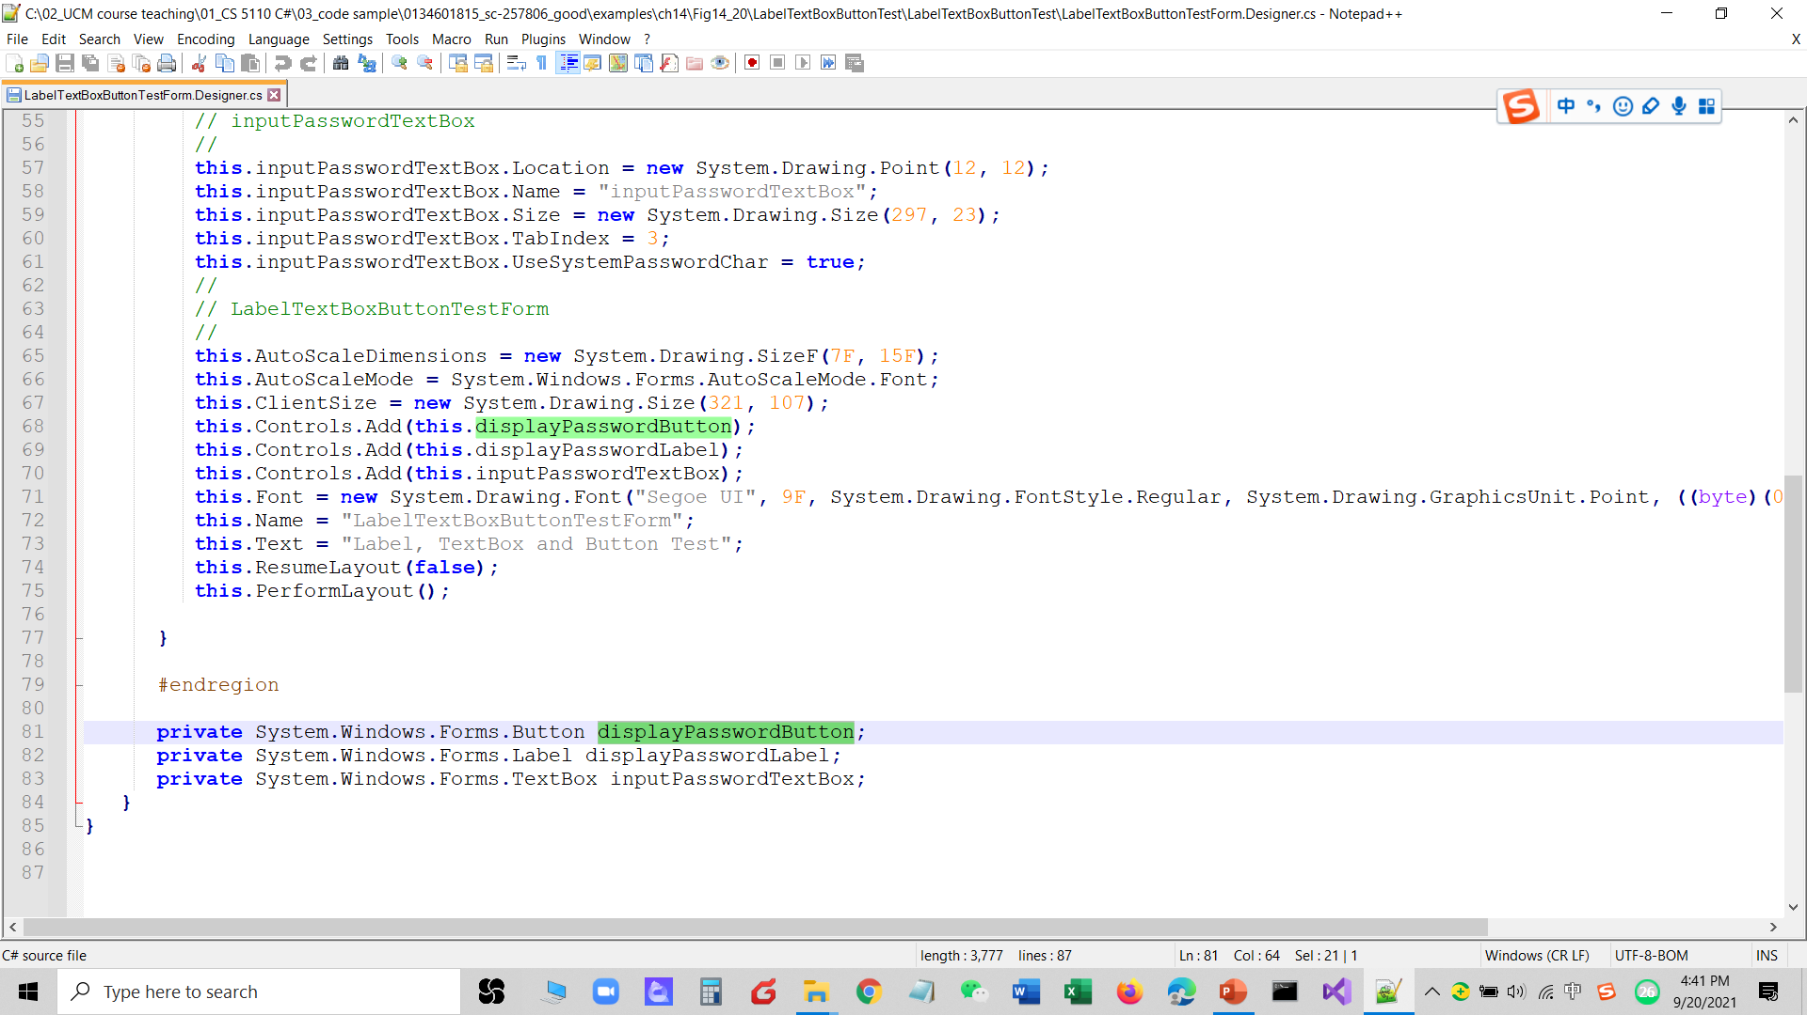

Slide 67
14.6 GroupBoxes and Panels(container?)
GroupBoxes and Panels arrange related controls on a GUI.
All of the controls in a GroupBox or Panel move together when the GroupBox or Panel is moved.
The primary difference is that GroupBoxes can display a caption and do not include scrollbars, whereas Panels can include scrollbars and do not include a caption.

Slide 68
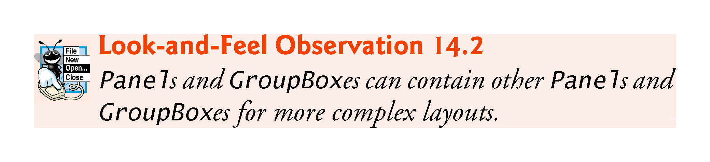

Slide 69
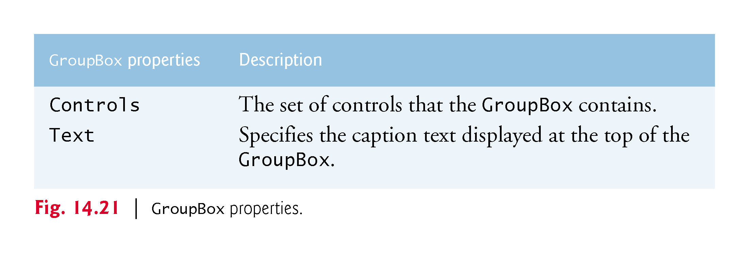

Slide 70
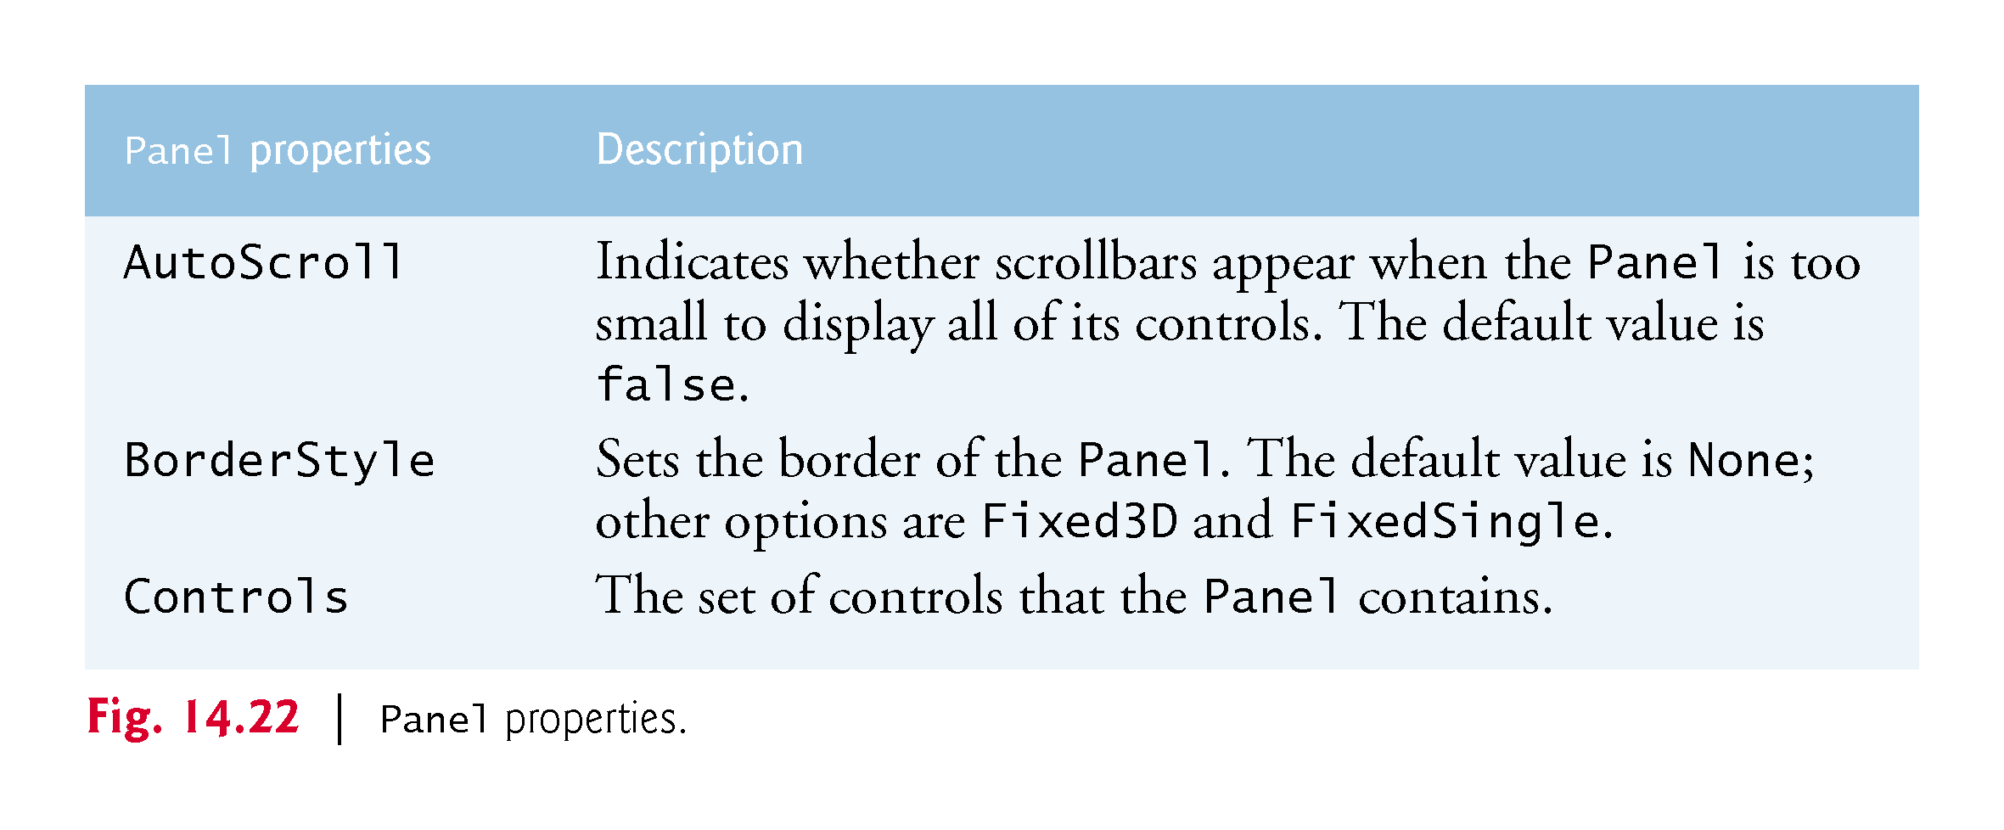

Slide 71
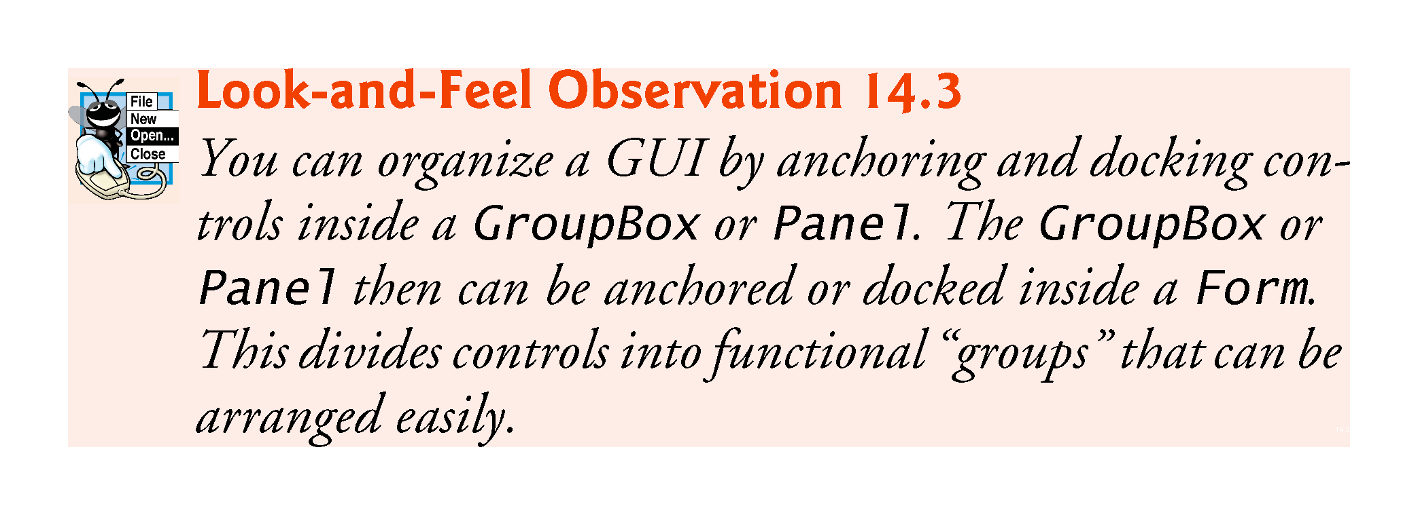

Slide 72
14.6 GroupBoxes and Panels (Cont.) p
To create a GroupBox or Panel, drag its icon from the Toolbox onto a Form.
Then, drag new controls from the Toolbox directly into the GroupBox or Panel.
To enable the scrollbars, set the Panel’s AutoScroll property to true.
If the Panel cannot display all of its controls, scrollbars appear (Fig. 14.23).
!!!
Design
process

Slide 73
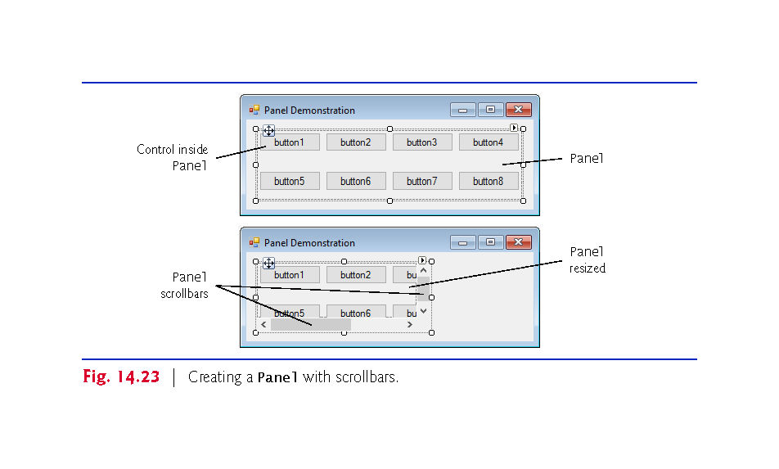

Slide 74
14.6 GroupBoxes and Panels (Cont.)
The program in Fig. 14.24 uses a GroupBox and a Panel to arrange Buttons.
!!!

Slide 75
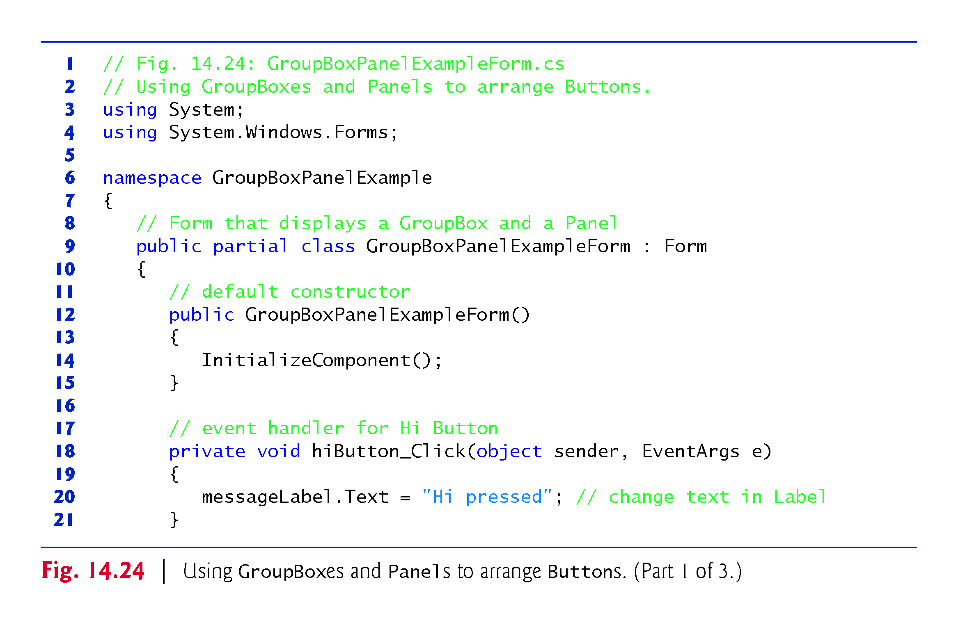

Slide 76
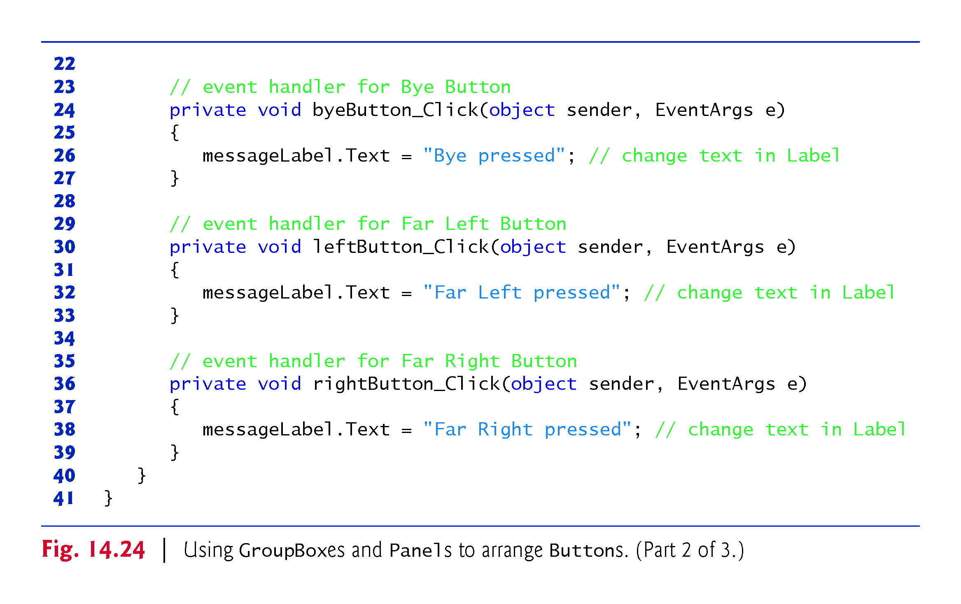

Slide 77
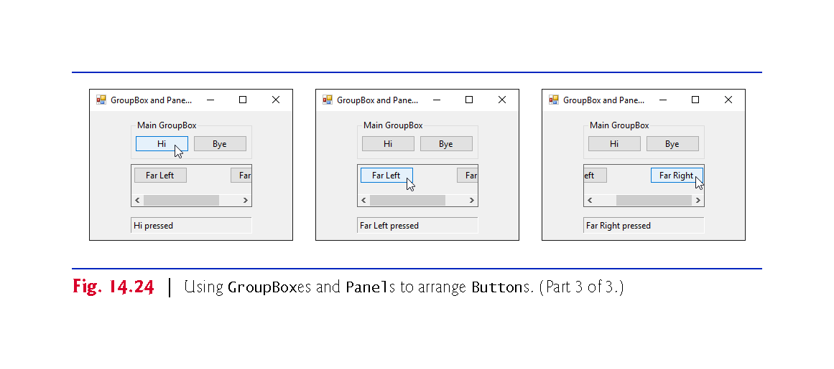
GroupBox
Panel

Slide 78
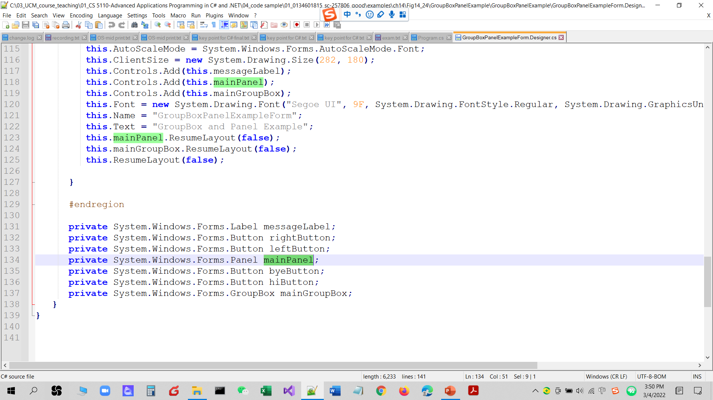

Slide 79
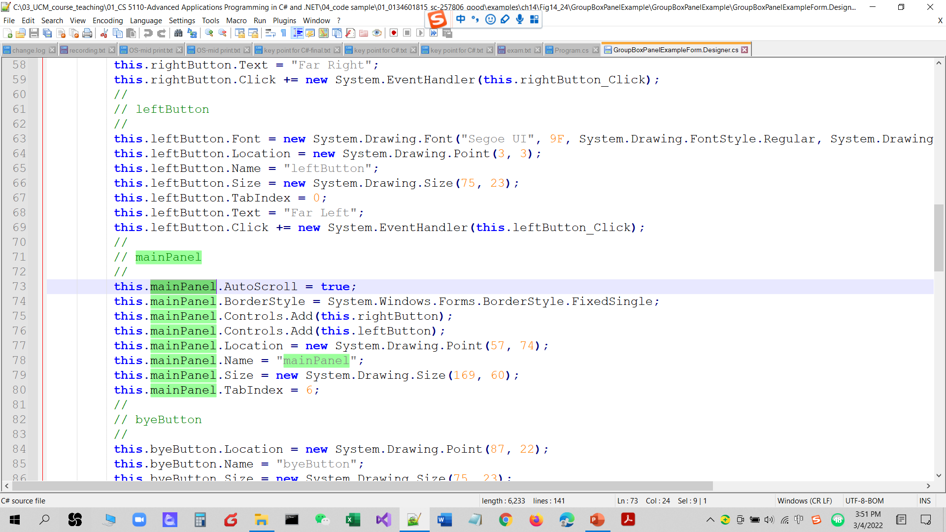

Slide 80
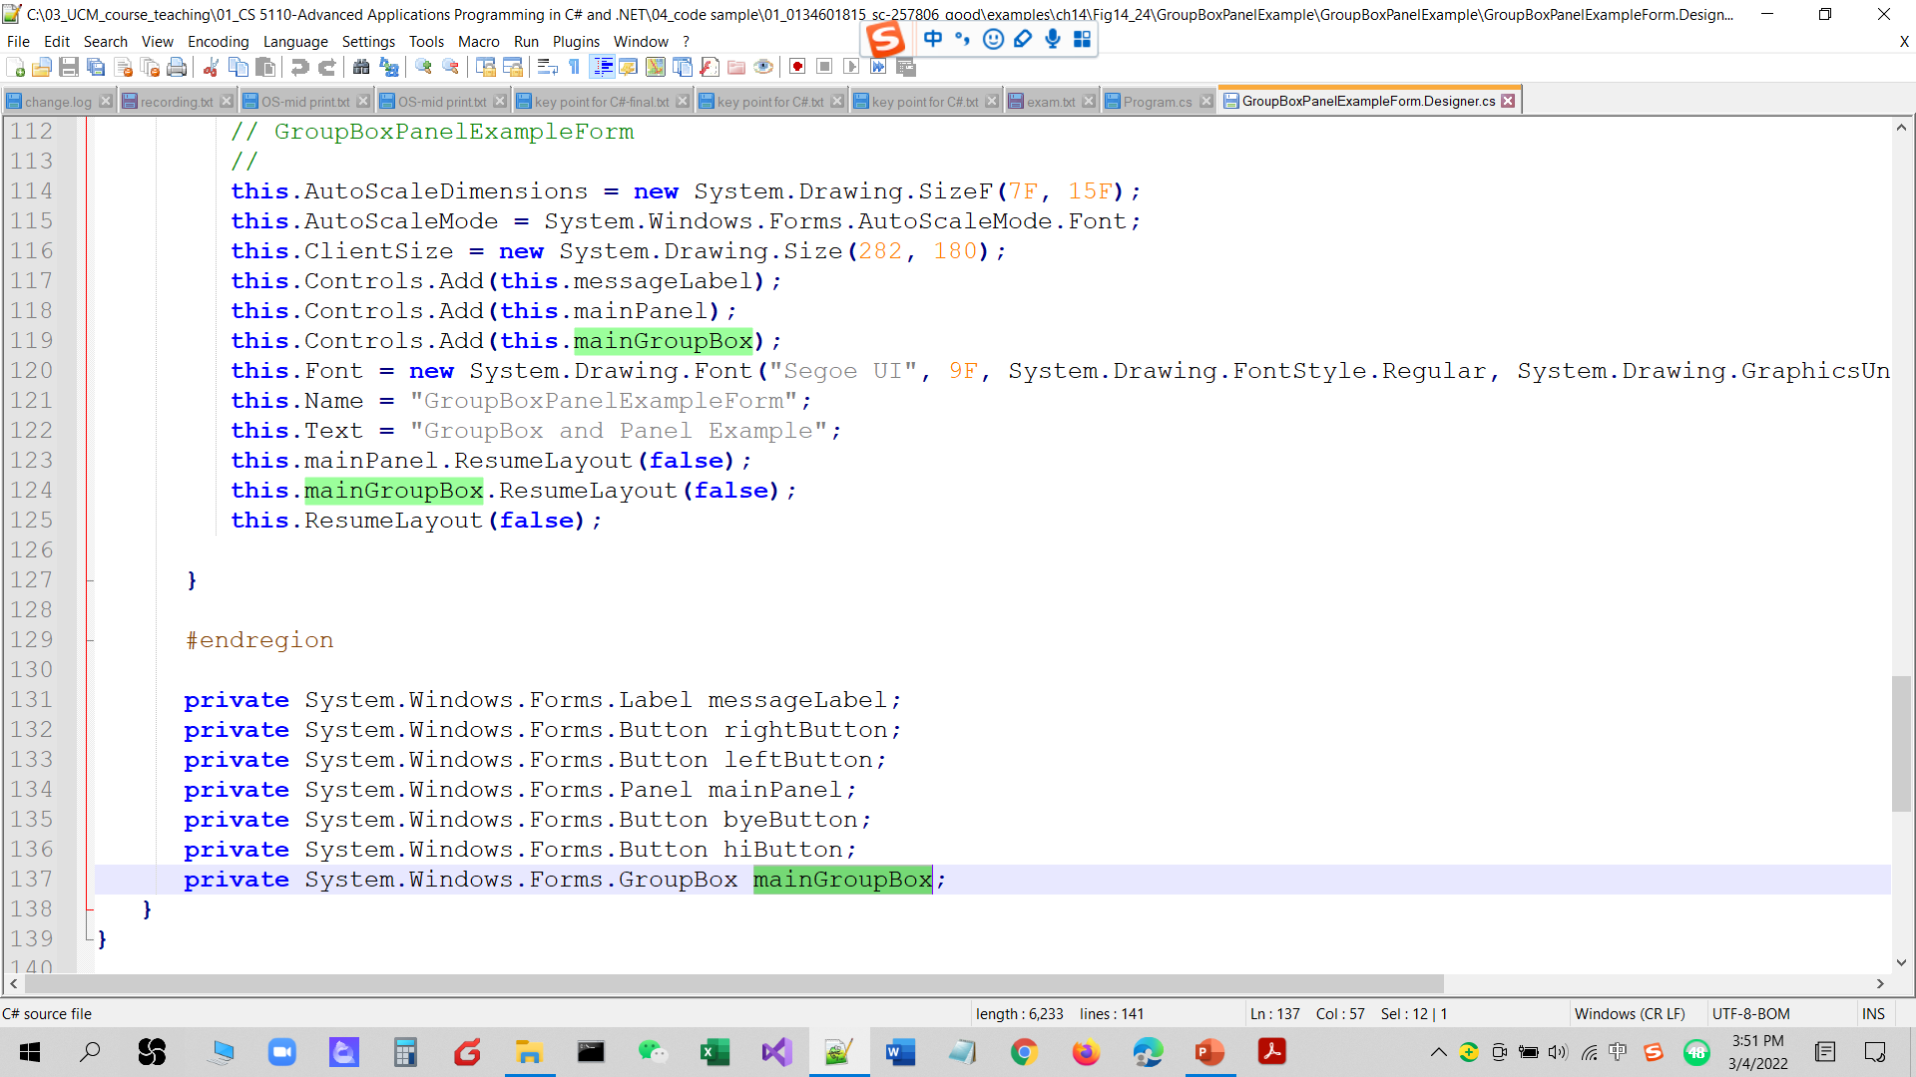

Slide 81
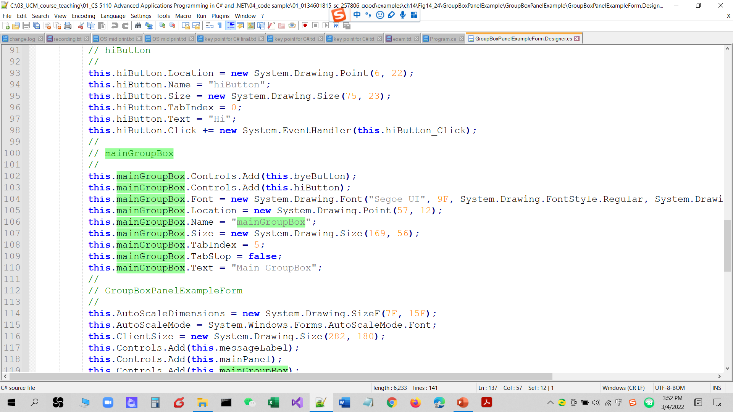

Slide 82
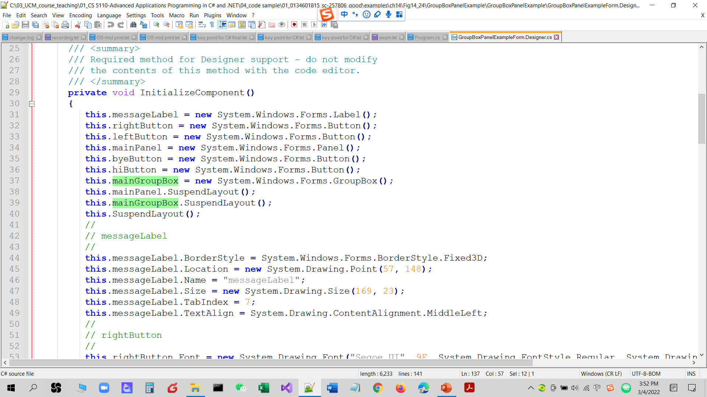

Slide 83
https://www.guru99.com/java-vs-c-sharp-key-difference.html
Diff C# and Java control and component??

Slide 84
14.7 CheckBoxes and RadioButtons
CheckBoxes
A CheckBox is a small square that either is blank or contains a check mark.
You can also configure a CheckBox to toggle between three states?? by setting its Three­State property to True.
Any number of CheckBoxes can be selected at a time.

Slide 85
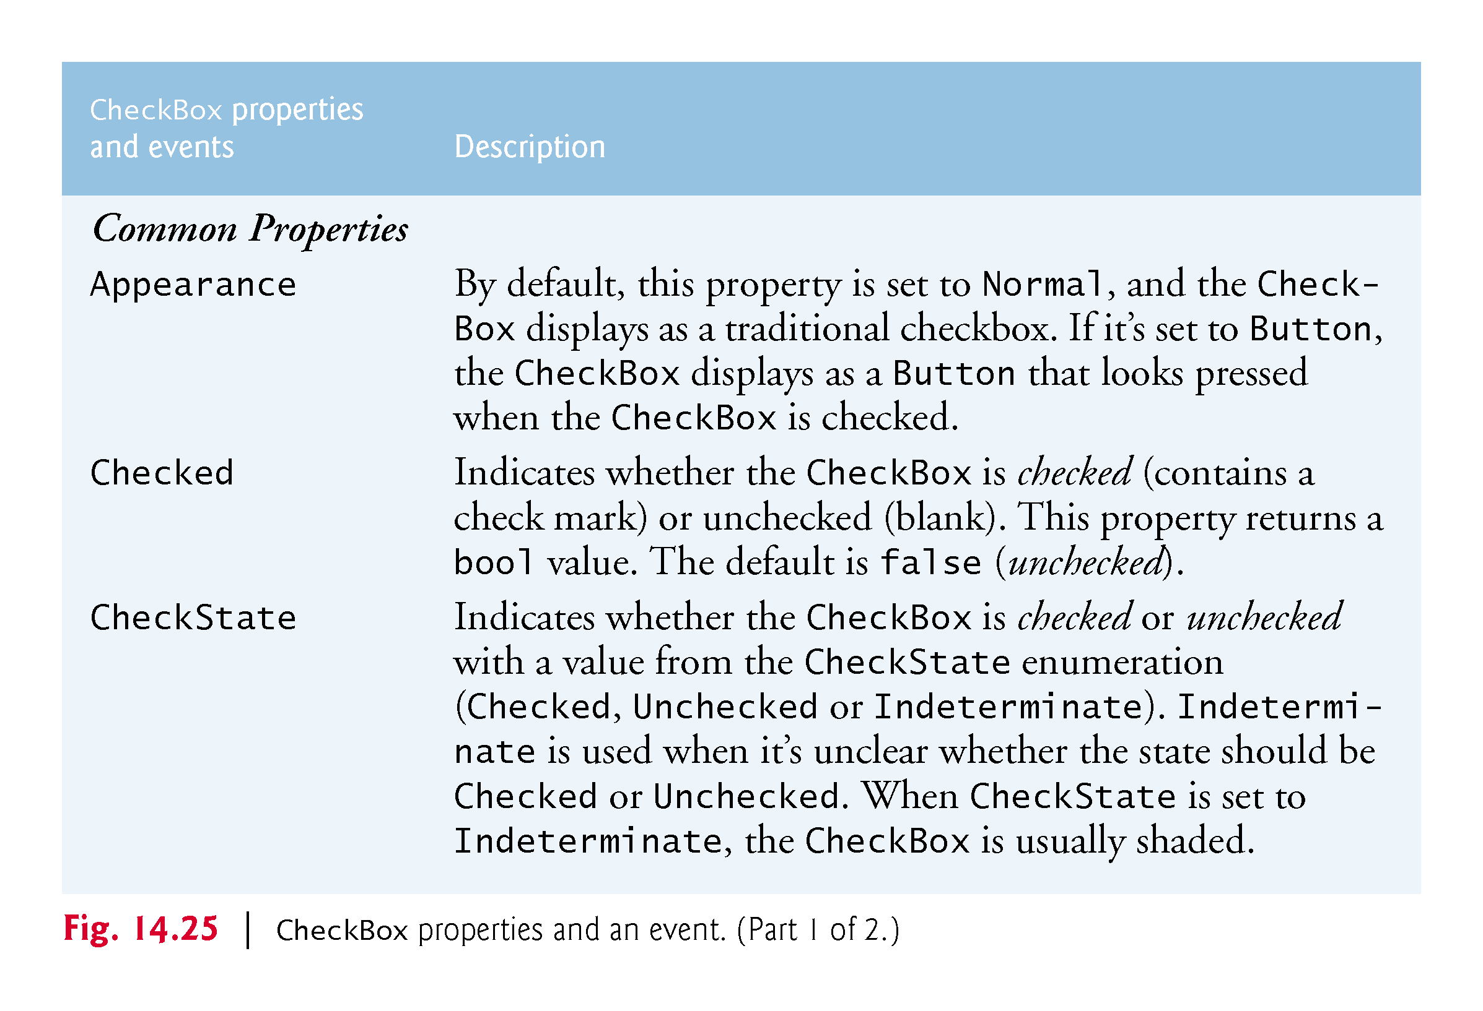

Slide 86
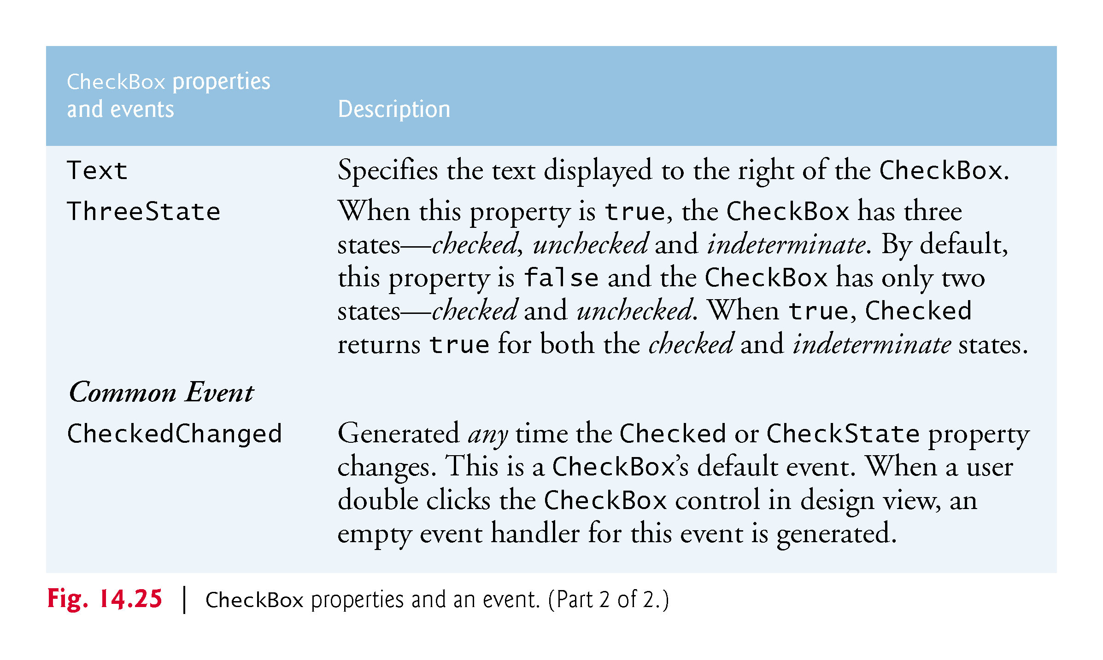

Slide 87
14.7 CheckBoxes and RadioButtons (cont.)
The program in Fig. 14.26 allows the user to select CheckBoxes to change a Label’s font style.

Slide 88


Slide 89


Slide 90


Slide 91


Slide 92


Slide 93
14.7 CheckBoxes and RadioButtons (Cont.)
To change the font style on a Label, you must set its Font property to a new Font object.
The Font constructor we used takes the current font and the new style as arguments.
Combining Font Styles with Bitwise Operators
Styles can be combined via bitwise operators—operators that perform manipulation on bits of information.
We needed to set the FontStyle so that the text appears in bold if it was not bold originally, and vice versa
The logical exclusive OR operator makes toggling the text style simple.

Slide 94
14.7 CheckBoxes and RadioButtons (Cont.)
RadioButtons
Radio buttons are similar to CheckBoxes in that they also have two states—selected and not selected.
RadioButtons normally appear as a group, in which only one RadioButton can be selected at a time.
All RadioButtons added to a container become part of the same group.

Slide 95
CheckBoxes and RadioButtons
https://www.adobe.com/support/ultradev/edit_database/insert_checkboxes/insert_checkboxes02.html
In a checkbox group, a user can select more than one option. Each checkbox operates individually, so a user can toggle each response "on" and "off.“
Radio buttons, however, operate as a group and provide mutually exclusive selection values. A user can select only one option in a radio button group.
f you want to enable your user to select more than one option in a group of choices, use checkboxes. If you want to restrict your user to one option, use radio buttons.
!!!

Slide 96

!!!

Slide 97



Slide 98


Slide 99


Slide 100
14.7 CheckBoxes and RadioButtons (Cont.)
The program in Fig. 14.28 uses RadioButtons to enable users to select options for a MessageBox.

Slide 101


Slide 102


Slide 103


Slide 104


Slide 105


Slide 106


Slide 107


Slide 108

Two groups

Slide 109


Slide 110


Slide 111
14.8 PictureBoxes
A PictureBox displays an image.
Figure 14.29 describes common PictureBox properties and a common event.

Slide 112


Slide 113


Slide 114
14.8 PictureBoxes
Figure 14.30 uses a PictureBox to display bitmap images.

Slide 115

imageNumber = -1

Slide 116


Slide 117


Slide 118

PictureBoxTestForm.Designer

Slide 119


Slide 120
14.8 PictureBoxes (Cont.)
Using Resources Programmatically
Embedding the images in the app prevents problems of using several separate files.
To add a resource:
Double click the project’s Properties node in the Solution Explorer.
Click the Resources tab.
At the top of the Resources tab click the down arrow next to the Add Resource button and select Add Existing File…
Locate the files you wish to add and click the Open button.
Save your project.

Slide 121
14.8 PictureBoxes (Cont.)
A project’s resources are stored in its Resources class.
Its ResourceManager object allows interacting with the resources programmatically.
To access an image, use the method GetObject, which takes as an argument the resource name as it appears in the Resources tab.
The Resources class also provides direct access with expressions of the form Resources.resourceName.

Slide 122
14.9 ToolTips
Recall that tool tips are the helpful text that appears when the mouse hovers over an item in a GUI.
Figure 14.31 describes common properties and a common event of class ToolTip.
!!!

Slide 123


Slide 124
14.9 ToolTips
A ToolTip component appears in the component tray—the region below the Form in Design mode.
A ToolTip on property for each ToolTip component appears in the Properties window for the Form’s other controls.
Figure 14.32 demonstrates the ToolTip component.

Slide 125


Slide 126
14.9 ToolTips (Cont.)
Figure 14.33 shows the ToolTip in the component tray.
We set the tool tip text for the first Label to "First Label" and the tool tip text for the second Label to "Second Label".

Slide 127


Slide 128
14.9 ToolTips (Cont.)
Figure 14.34 demonstrates setting the tool-tip text for the first Label.

Slide 129


Slide 130
14.10 NumericUpDown Control (cont.)
Restricting a user’s input choices to a specific range of numeric values can be done with a NumericUpDown control.
A user can type numeric values into this control or click up and down arrows.
Figure 14.35 describes common NumericUpDown properties and an event.

Slide 131


Slide 132


Slide 133
14.10 NumericUpDown Control
Figure 14.36 demonstrates a NumericUpDown control in a GUI app that calculates interest rate.
For the NumericUpDown control, we set the Minimum to 1 and the Maximum to 10.
We set the NumericUpDown’s ReadOnly property to true to indicate that the user cannot type a number into the control.

Slide 134


Slide 135


Slide 136


Slide 137


Slide 138


Slide 139


Slide 140
14.11 Mouse-Event Handling
Mouse events are generated when the user interacts with a control via the mouse.
Information about the event is passed through a MouseEvent­Args object, and the delegate type is Mouse­EventHandler.
MouseEventArgs x- and y-coordinates are relative to the control that generated the event.
Several common mouse events and event arguments are described in Figure 14.37.

Slide 141


Slide 142


Slide 143
14.11 Mouse-Event Handling
Figure 14.38 uses mouse events to draw on a Form.

Slide 144


Slide 145


Slide 146


Slide 147


Slide 148
13.6-review The using statement
The using statement simplifies writing code in which you obtain a resource（create a object）.
The general form of a using statement is:
using (var exampleObject = new ExampleClass()) { exampleObject.SomeMethod(); }
!!!
Rewrite!!

Slide 149
13.6-review The using statement (Cont.)
The using statement code is equivalent to
{ var exampleObject = new ExampleClass(); //claim some resource try { exampleObject.SomeMethod(); //the method might claim some resource } finally { if (exampleObject != null) { ((IDisposable) exampleObject).Dispose(); //release resource } } }
!!!

Slide 150
14.11 Mouse-Event Handling (Cont.)
Recall from Chapter 13 that the using statement automatically calls Dispose on the object that was created in the parentheses following keyword using.
This is important because Graphics objects are a limited resource.
Calling Dispose on a Graphics object ensures that its resources are returned to the system for reuse.

Slide 151
14.12 Keyboard-Event Handling
There are three key events:
The KeyPress event occurs when the user presses a key that represents an ASCII character.
The KeyPress event does not indicate whether modifier keys (e.g., Shift, Alt and Ctrl) were pressed; if this information is important, the KeyUp or KeyDown events can be used.

Slide 152


Slide 153


Slide 154


Slide 155


Slide 156


Slide 157


Slide 158


